Slide 1
Forecasting using Data
Hamburg
November 2019
Troy.Magennis@focusedobjective.com
@t_magennis

Slide 2
Whilst getting settled - Write on an index card
“The one topic you would be disappointed if you didn’t learn today”

Slide 3
Introductions and logistics
About me …
Email: troy.magennis@focusedobjective.com
Twitter: @t_magennis
My GitHub life: http://bit.ly/SimResources
About you …
Your name
One thing you would be disappointed if you didn’t learn today
Venue

Slide 4
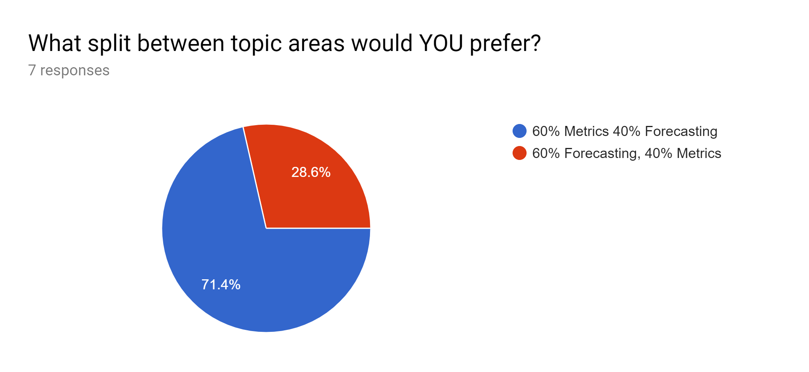
Metrics or Forecasting

Slide 5
Metrics or Forecasting
Seeing examples for easy using data to forecast
When I have more than one team and every team is delivering stuff for one goal, how can I implement a forecasting system that doesn’t need much afford and delivers a rolling forecast over all teams?

Slide 6
Attendee Selected Topics
Clear Yes -> Added to the day
Dependency Impact Planning & Management (this is your 2 15 mi slots, don't choose any other 15 min)
Why >80 Utilization Sucks
Top 3 Forecasting Fails
Clear Yes, but just the main points -> Going to cover when they come up
Detecting Fraudulent Data
Time Series Forecasting (Demand)
Skill Assessment Mapping
Clear No -> Catch me at lunch or the breaks
Estimating Scope Growth
Forecasting before you have empirical data
How many defects remain?

Slide 7
Agenda Options – Decision Time
Choice – morning or afternoon
Forecasting
10% talking, 90% hands on exercises
Metrics
70% talking, 30% hands-on exercises

Slide 8
Probability & Forecasting
Dealing with ambiguity

Slide 9
Exercises – intro to probability (~20 minutes)
Goal
Undo the damage of school taught statistics
How
Do the exercise shown on pages 2 and 3. Don’t overthink it!
Lets get a feel for sample sizes required for statistics & forecasting
Physical demo
Prediction interval exercise page 5 of your workbook
Debrief
Probability: Number of “like” things / Total number of “all” things
You need less data than you think –> 7 to 11 samples IN CONTEXT

Slide 10
How many samples to use?
< 3 samples
Guess the range, go wide
4-7 samples
Narrow guessed range using data
7-15 samples
Use data
> 15 samples, delete the oldest and use the newest
Always – look for reasons historical data is no longer relevant
Sampling Error
Poorly measured
unlucky
Context Error
Crunching / OT
New tech
New team

Slide 11
Exercise – “when should I leave?” (~1 hour)
Goals
Learn how the basic “distance” / “velocity” model for forecasting works
Learn how to incorporate data uncertainty and context into forecasts
Learn how to incorporate risk and cost of delay into forecasts
How
Exercise on page 6and 7 of your workbooks
Debrief
Start with a simple model and think “why would this be wrong” – repeat
Context is everything. Peak traffic times can be more impact than distance

Slide 12
BREAK – 15 minutes
Restarting:

Slide 13
Agile Probabilistic Forecasting
Forecasting Agile projects using probabilistic techniques

Slide 14
1. Average pace forecast (simple regression)
2. Pace estimate as a range (probabilistic forecast)
3. Pace Mathematical Distribution (probabilistic forecast)
4. Pace Historical Data Distribution (probabilistic forecast)
5. System simulation probabilistic forecast
Forecasting “How Long” Models
Typical Agile Here
This training gets you here
Low effort, Low chance
High effort, High chance
Effort AND how likely model represents actual outcome

Slide 15

Predictive Analytics
Notes:
Forecasting is about setting better expectations about what reality will eventually unfold.
Expectations are subject to all manner of biases, wishful thinking and incomplete logic. Out job in forecasting is to narrow that gap, better align forecast to reality.
Its about demonstrating we understand the wholistic delivery system well enough that we can make better, more informed decisions earlier.

Slide 16
Model
Compare Reality
Forecast
Models are always wrong. It’s all about understanding why.

Slide 17
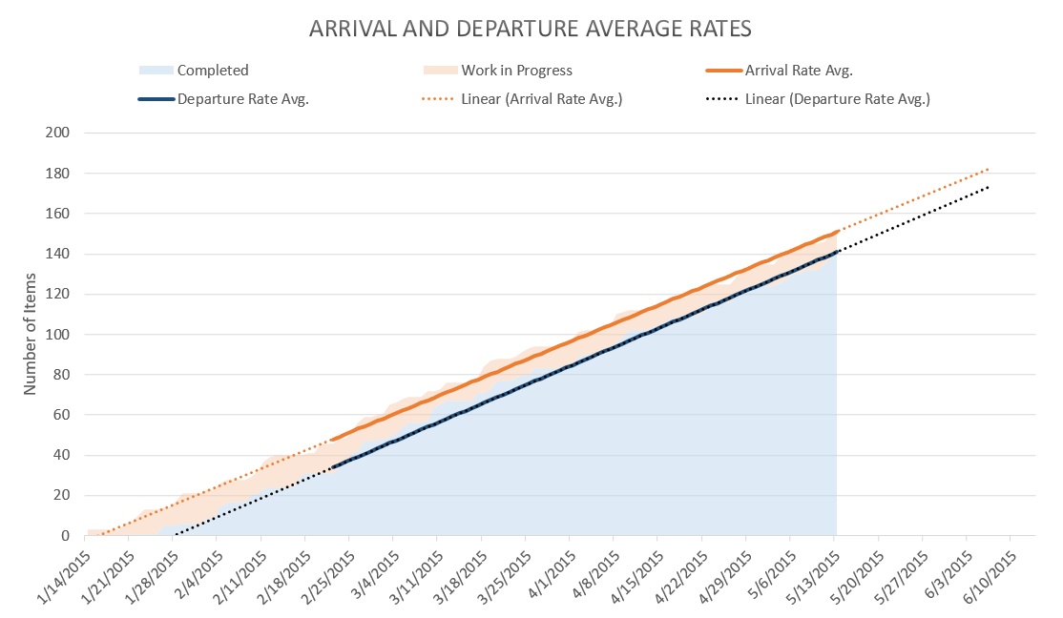
ONLY believe THIS
IF you see THIS

Slide 19
1. Model using historically known truths (train)
2. Test Model against historically known truths
(test)
3. Forecast
January
February
March
April
May
June
July
August
September
The Past
The Future
Back-testing: Using the data you have to predict something known

Slide 20
Forecasting is about detecting EARLIER that you are WRONG
Until you can forecast something you KNOW happened, stick clear of forecasting the FUTURE
@t_magennis

Slide 21
Throughput per week for 100 teams

Slide 22
Trend – Seasonality – Noise (Special Cause)
Best LONG TERM predictor = Trend
Best MEDIUM TERM predictor = Trend + Seasonality
Immediate Term: Worry about special concerns
Trend
Seasonality / Pattern
Noise (Special cause)

Slide 23

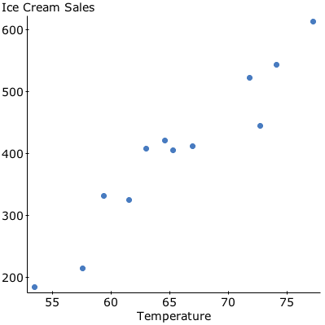
What factors might impact demand?
This Photo by Unknown Author is licensed under CC BY

Slide 24



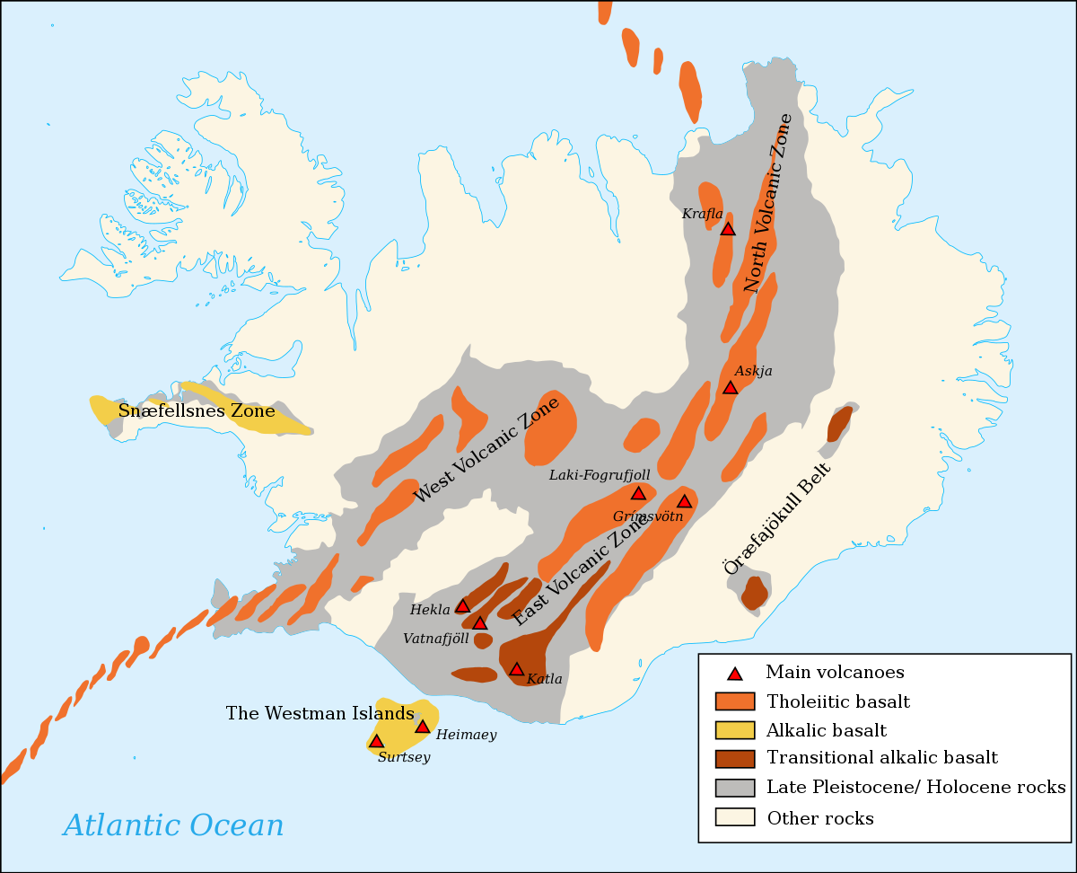

Special Cause Variation (predictability varies)
This Photo by Unknown Author is licensed under CC BY-SA
This Photo by Unknown Author is licensed under CC BY-SA
This Photo by Unknown Author is licensed under CC BY

Slide 25
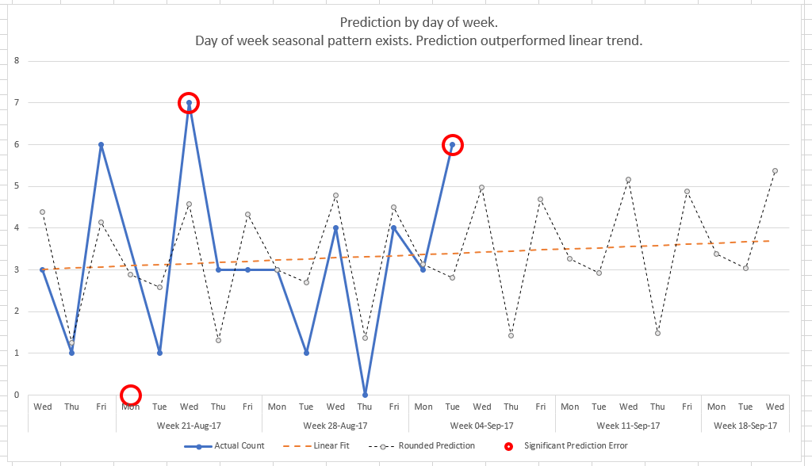
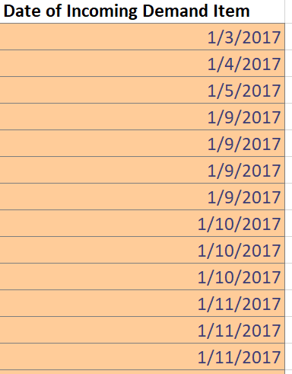
Special Cause?
http://bit.ly/DemandForecasting

Slide 26
Know what factors are important in YOUR CONTEXT Trend – Patterns – Special Cause
Best LONG TERM predictor = Trend
Best MEDIUM TERM predictor = Trend + Patterns
Immediate Term: Worry about special causes
@t_magennis

Slide 27
Yeah, but how long will THIS feature take?

Slide 28
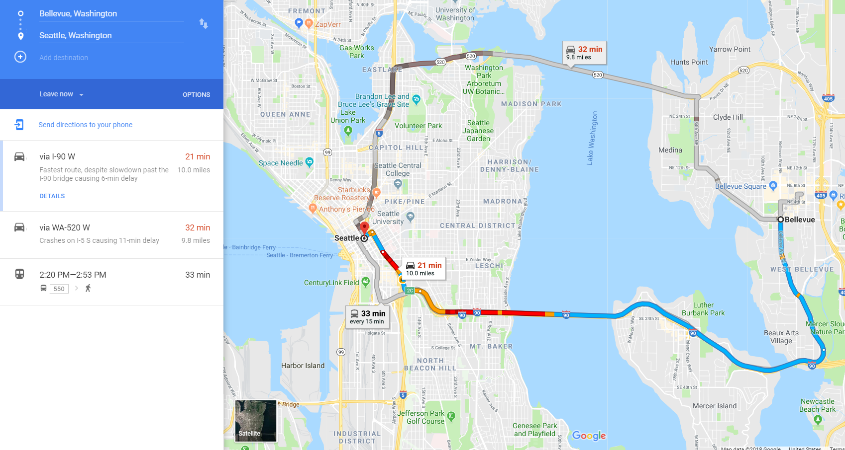
Duration, not ETA
Until you start, then continuously updated with Time Remaining using latest traffic data
Multiple options
Notes:
Google Maps emerged about 10 years ago. It’s now pretty ubiquitous when we want to travel in unfamiliar areas that we se our phones to navigate. It has save my and many other marriages I suspect.
Being around for 10 years means its undergone a lot of refinement, and is a pretty good reference to learn how to present forecass.
There is some subtleties that we can easily use in forecasting software and IT projects.
First off, it doesn’t show just one option, it shown many. Here, two driving alternatives and a public transport alternative. It keeps the human in the decision loop. It presents options, even highlighting the fastest one, but it clearly shows the others in case there is some compelling reason they are useful.
Second, it doesn’t give an arrival time yet. It gives duration. Obviously, it doesn’t yet know when we are leaving home.
Thirdly, once we do commit to one of the options, it gives us continuously updated arrival time information. It incorporates the latest traffic issues based on traffic flow ahead of us and even suggests alternative routes if its original turns out to be less ideal.

Slide 29
Contrast Software Planning to Google Maps
If you currently…
Consider doing…
Give one forecast even though multiple approaches considered
Give a calendar date for undefined “complete” & “start”
If the original date is in doubt we find out near the end
Give multiple options of investment and implementation
Give a duration and define what started & complete means
If the original date is in doubt, know earlier and react faster
Notes:
So, lets incorporate that into our world.
Lets NOT give a single answer, lets show the options we have considered in case they offer some advantage we haven’t considered.
Lets NOT give a calendar delivery date until the project has started, lets make decisions using duration in weeks or sprints as a way to decide what option to pick.
Lets NOT perform heroics at the very end of a project, lets continuously track our progress against the forecast and adapt and react quickly, earlier.
I’m going to show you how I incorporate these aspects into my forecasting engagements.

Slide 30

Why Use Probabilistic Forecasting?
Why not just use average or min or max?
To avoid compounding local safety and way too long/short estimates
To avoid “The Flaw of Averages”
50% Possible Outcomes
50% Possible Outcomes

Slide 31
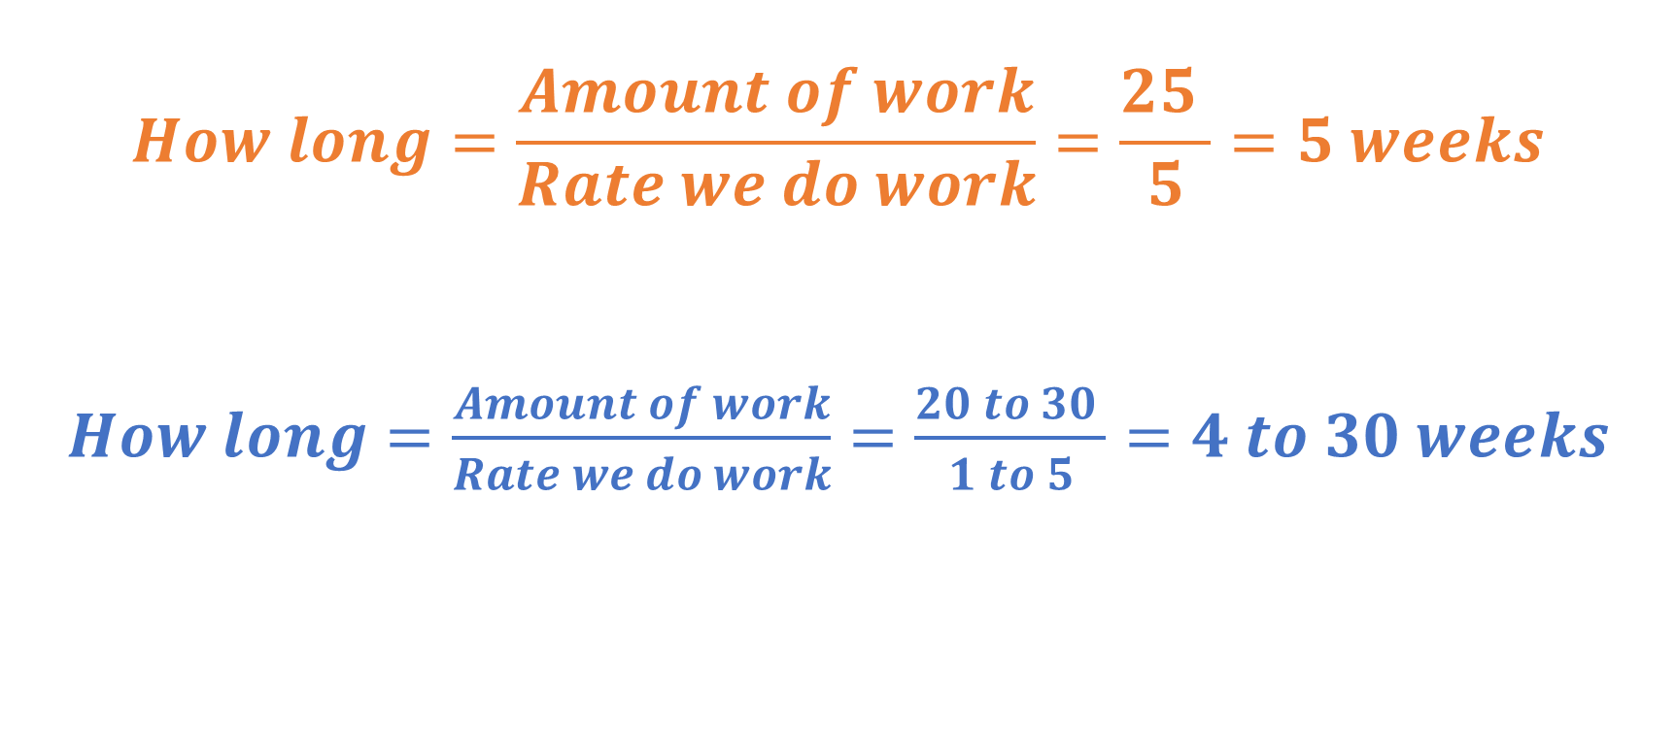
Normal Math
vs Probabilistic Math
$$How long=\frac{Amount of work}{Rate we do work}=\frac{25 }{5}=5 weeks$$
$How long=\frac{Amount of work}{Rate we do work}=\frac{20 to 30 }{1 to 5}=4 to 30 weeks$
INSERT YOUR DATA HERE

Slide 32
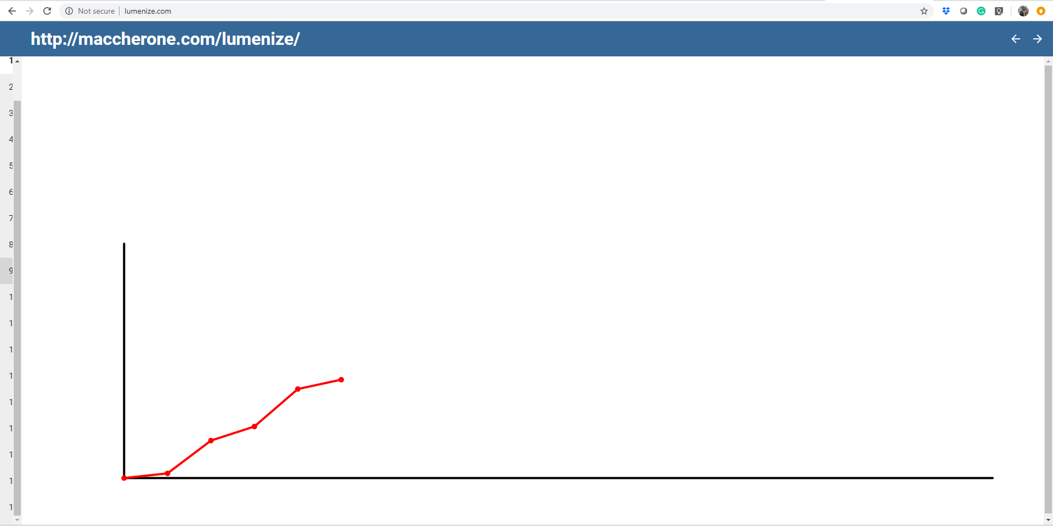
Week/Sprint Throughput Samples
Thanks @maccherone ☺

Slide 33
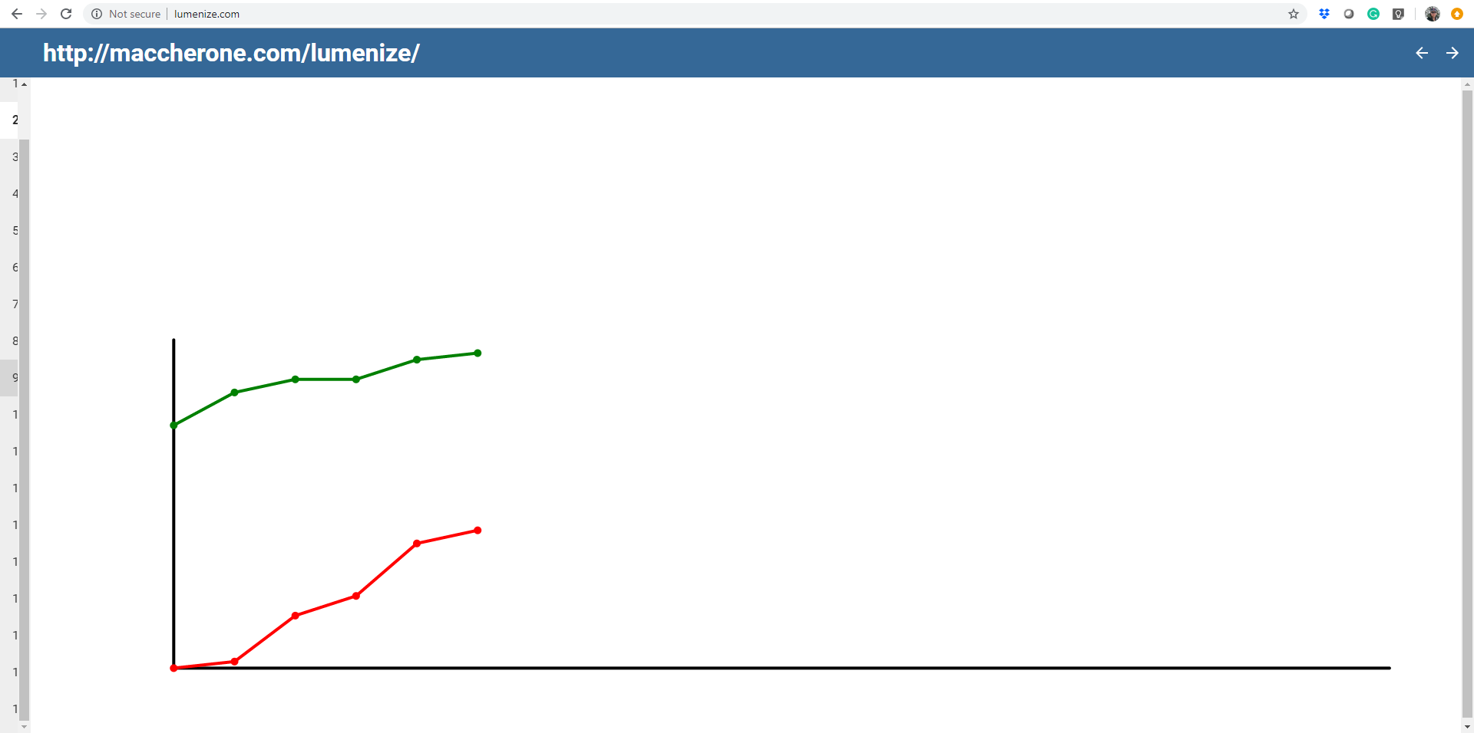
Backlog of Work
Week/Sprint Throughput Samples

Slide 34
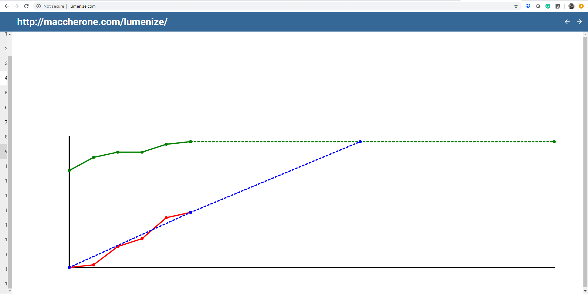

Linear Projection gives us a “Date”
But how CERTAIN are we of delivering by that date?
This Photo by Unknown Author is licensed under CC BY-SA-NC

Slide 35
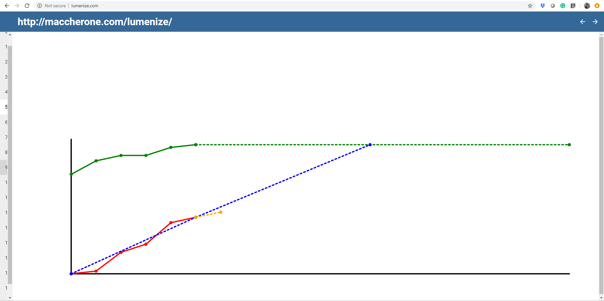

Slide 36


Slide 37
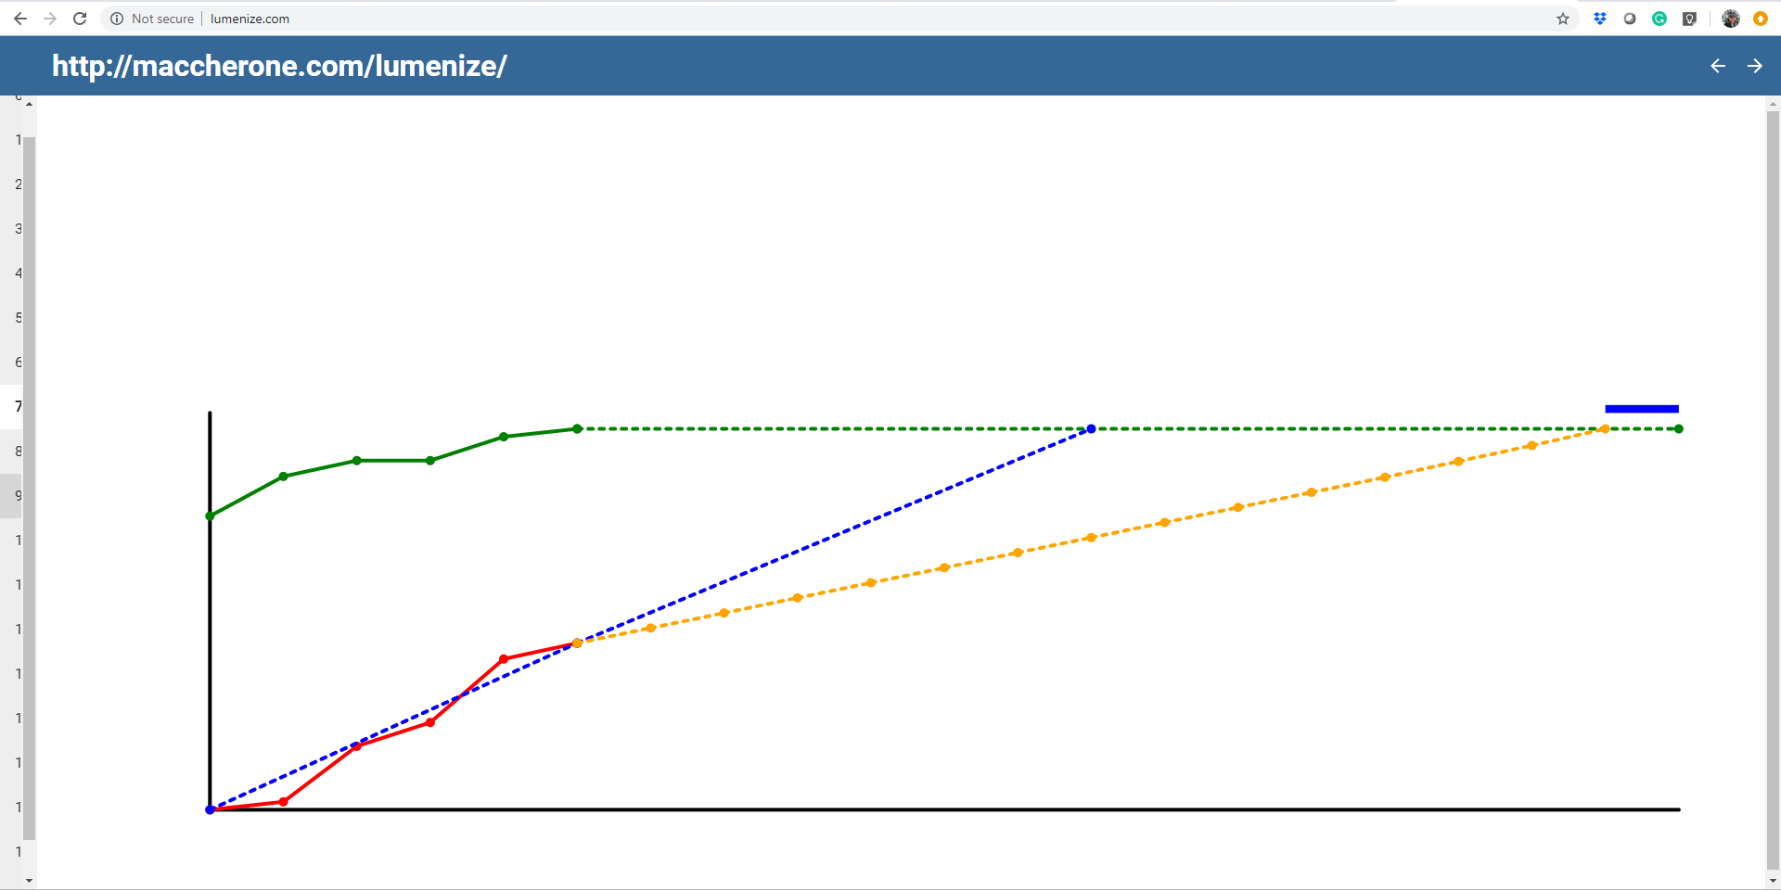

Slide 38


Slide 39
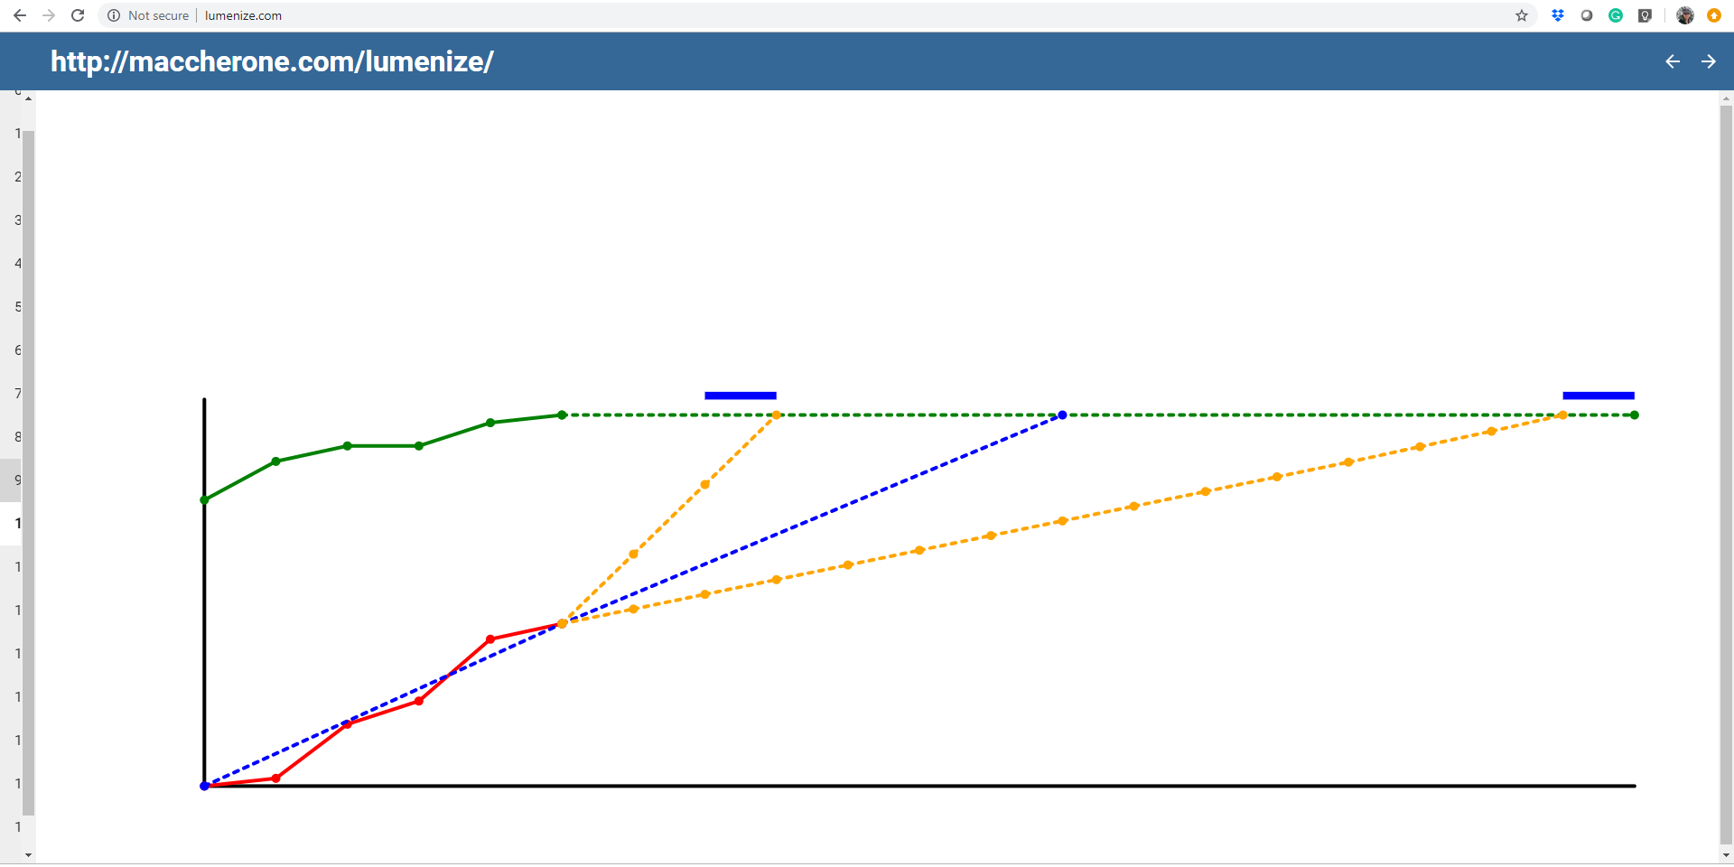
Cancel the PROJECT
Projection using best case
Projection using worst case
This Photo by Unknown Author is licensed under CC BY-NC
This Photo by Unknown Author is licensed under CC BY-NC

Slide 40
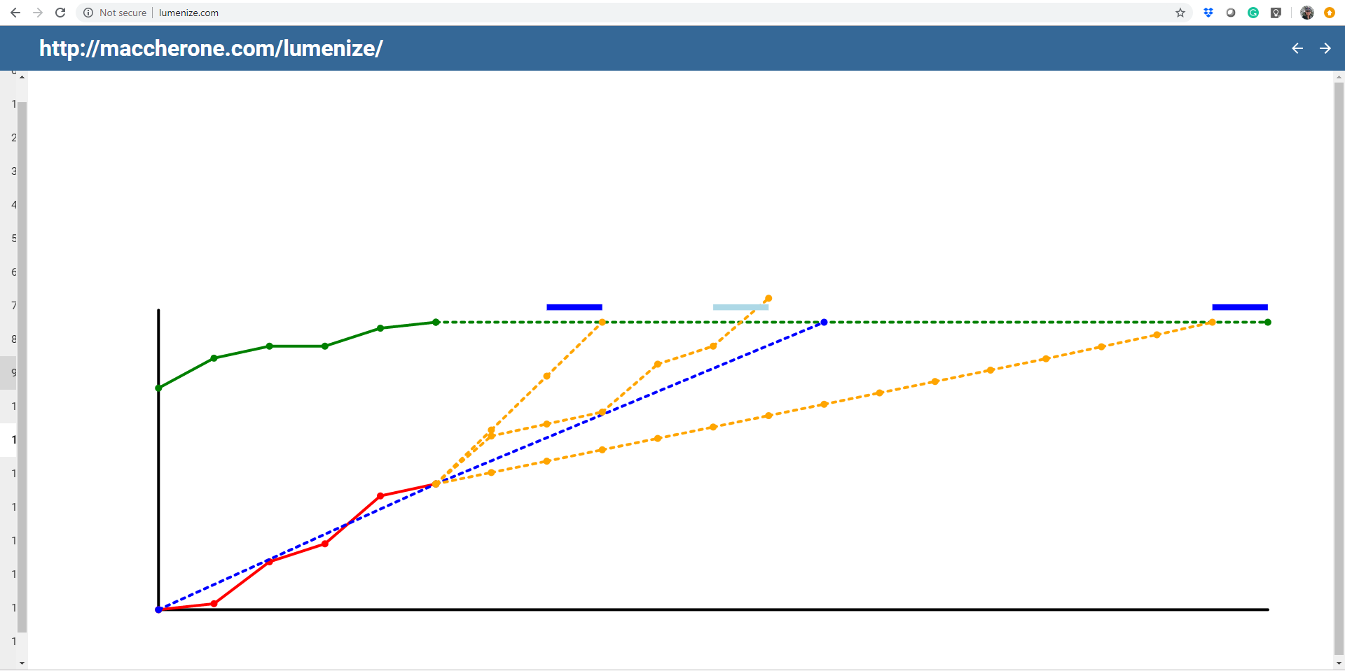

Slide 41
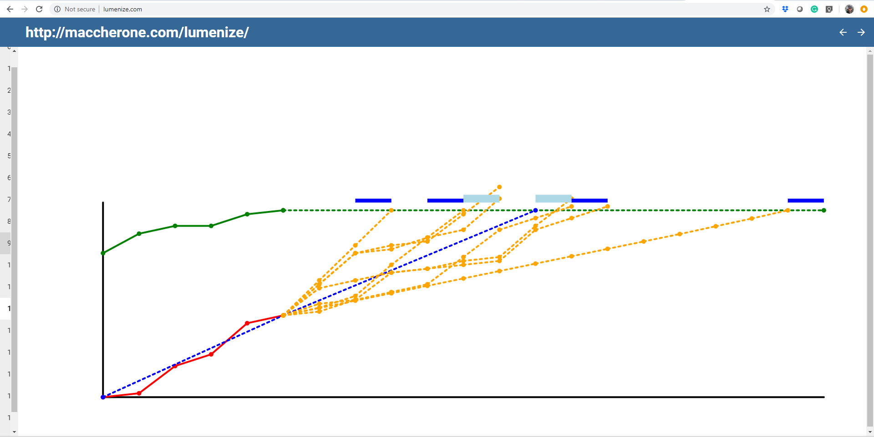

Slide 42
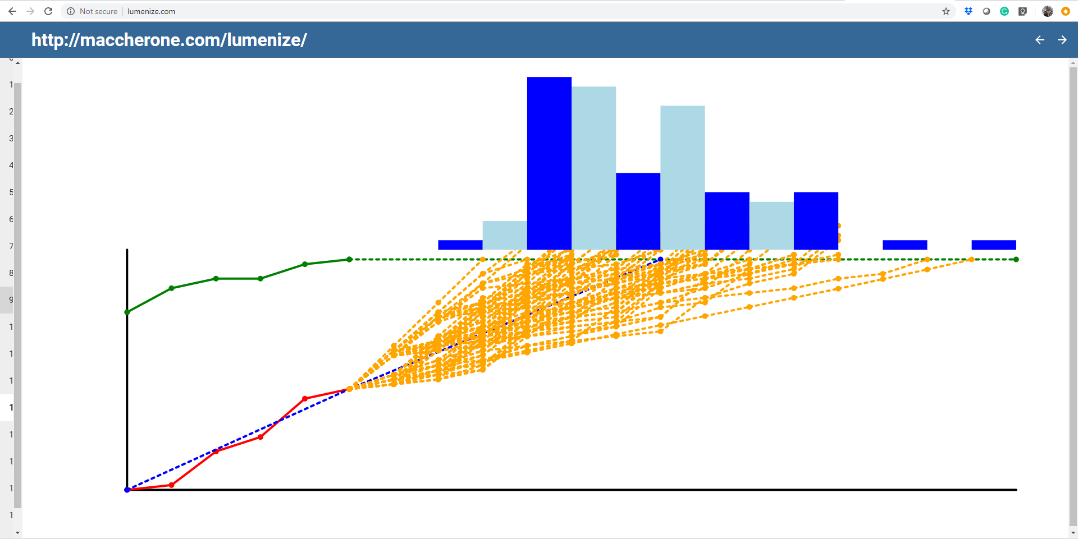
How to avoid these?
85th Percentile

Slide 43
Avoid the FLAW of AVERAGES
There NEVER is ONE answer in an uncertain world
Balance Recency with Sample Size
Use DATA after 7 samples
@t_magennis

Slide 44
Exercise – Monte Carlo forecasting (20 min)
Goal
Learn how simple Monte Carlo forecasting is in reality
Solidify how probabilities work and are explained
How
Exercise on pages 8 and 9 of your workbook
Debrief
Resampling data correctly computes probabilities based on your variability
Monte Carlo is simply doing mathematics on distributions – nothing more

Slide 45
Known as Reference Class Forecasting
Notes:
Keeping a history of features and how many stories or story points it took to deliver those features is an excellent way to maintain knowledge and lessons over time.
Here is a quick and practical way. Whenever you deliver a feature, tally up the story count and a short description and place them on a wall somewhere sorted from lowest to highest.
When you are asked how big Feature 4 might be, walk over to the wall with the stakeholder and a few team members and pick where it fits. Done.
Teams doing this well can estimate size of 30 features an hour. Better still, the stakeholder start to get the feel of relative feature size quickly and only ask the team on rare occasions.
It has another benefit. It avoids all manner of cognitive biases and wishful thinking. It also captures that some even simple sounding work turned out hard by recording the eventual story count. This is an easy win for any organization.

Slide 46
Exercise – forecasting end to end (>1 hour)
Goal
Apply rapid probabilistic forecasting to planning a whole portfolio
Learn about reference class forecasting, story count forecasting, single & multiple story count forecasting and basic cost of delay spreadsheets
How
Groups, at least on laptop who can run the spreadsheets at http://Bit.Ly/ForecastingExercise
Exercise starts page 19 of your workbooks – !! but wait to be told to start !!

Slide 47
LUNCH – 1 Hour
Things to do over the lunch break –
Eat (most important)
Optional exercises (just so you know the theory behind the spreadsheets) -
Story count forecast exercise starting on pages 9 to 12 (15 minutes)
Throughput forecast exercise starting on pages 13 to 15 (15 minutes)
Restarting at 1:30pm

Slide 48
Charts and Dashboards
Visually displaying information for action and stuff….

Slide 49
Dashboard Types – Definition and Use Cases
Strategic dashboards track key performance indicators.
Analytical dashboards process data to identify trends.
Operational dashboards tell you what is happening now.
Q. What type of dashboard is suited for?
1. Observing OKRs
2. Identifying Operational Issues
3. Managing Development Teams

Slide 50
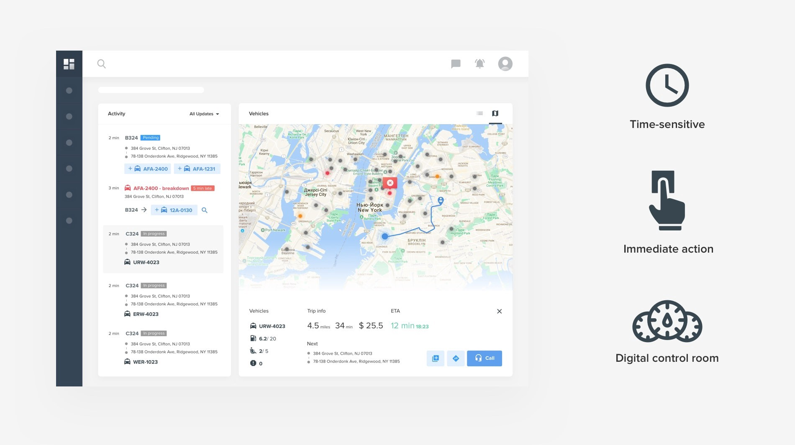
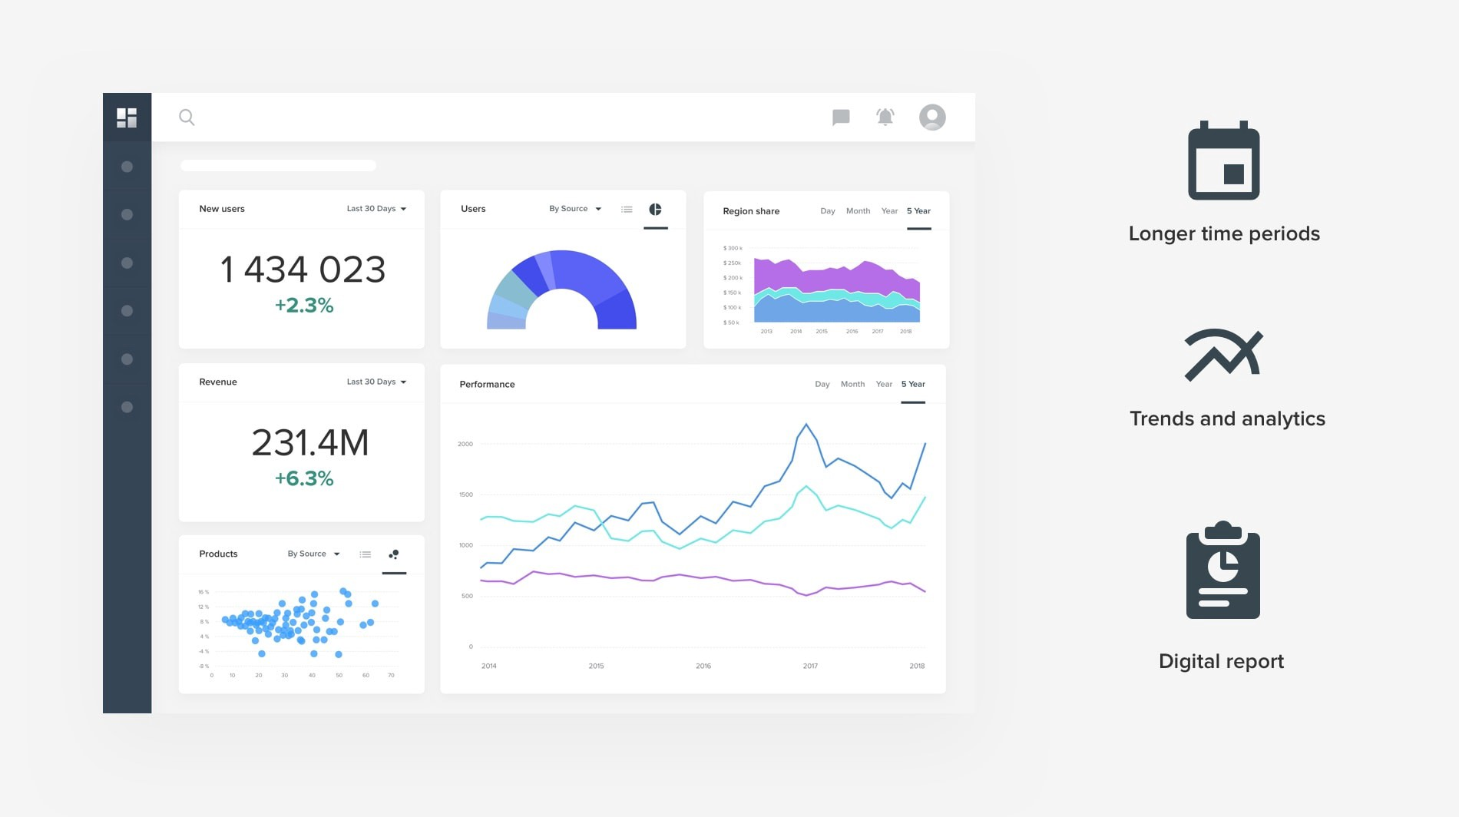
Dashboard types
Operational Dashboard
Analytical Dashboard
Time sensitive insights
Insight causes action
Value based alerting
Longer time needed for insights
Insight causes discussion
Trend based alerting

Slide 51
For the largest number of people,
provide the greatest degree of understanding
of the intended and most important insights with the least amount of effort and stress.
~Steve Wexler with additions by Troy Magennis

Slide 52
Dashboard Design
TURN INSIGHTS INTO DECISIONS INTO ACTIONS
WHAT – SO WHAT – NOW WHAT
(from Larry Maccherone & Edward Tufte)
Know the audience – location, insight time, reaction time
Know what insights to show by what decisions need to be made
Understand the importance each insight and highlight accordingly
Segment data so that comparisons can be made in context
Allow users to delve deeper into data, don’t show deep data first

Slide 53
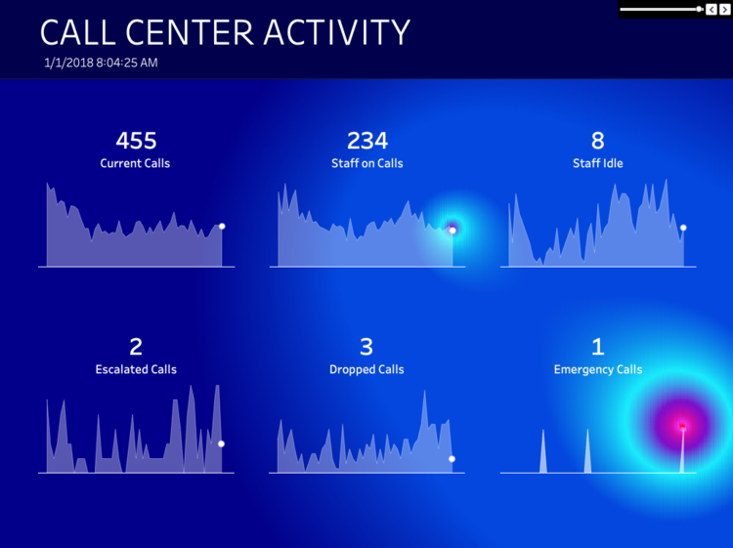
In 10 seconds, tell me an INSIGHT from the dashboard

Slide 54
For the largest number of people,
provide the greatest degree of understanding
of the intended and most important insights with the least amount of effort and stress.
~Troy Magennis (modified from Steve Wexler, Data Revelations)

Slide 55
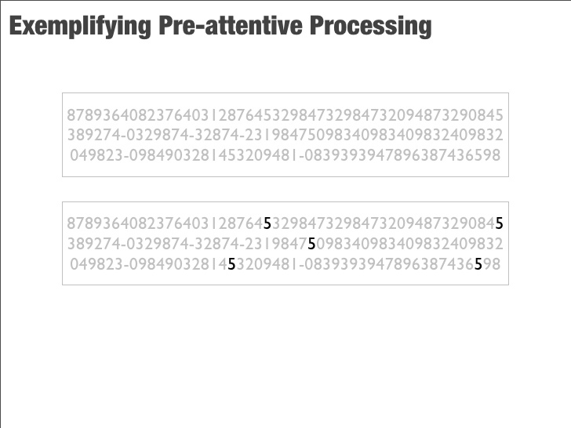
Pre-attentive – How many 5’s are there?

Slide 56
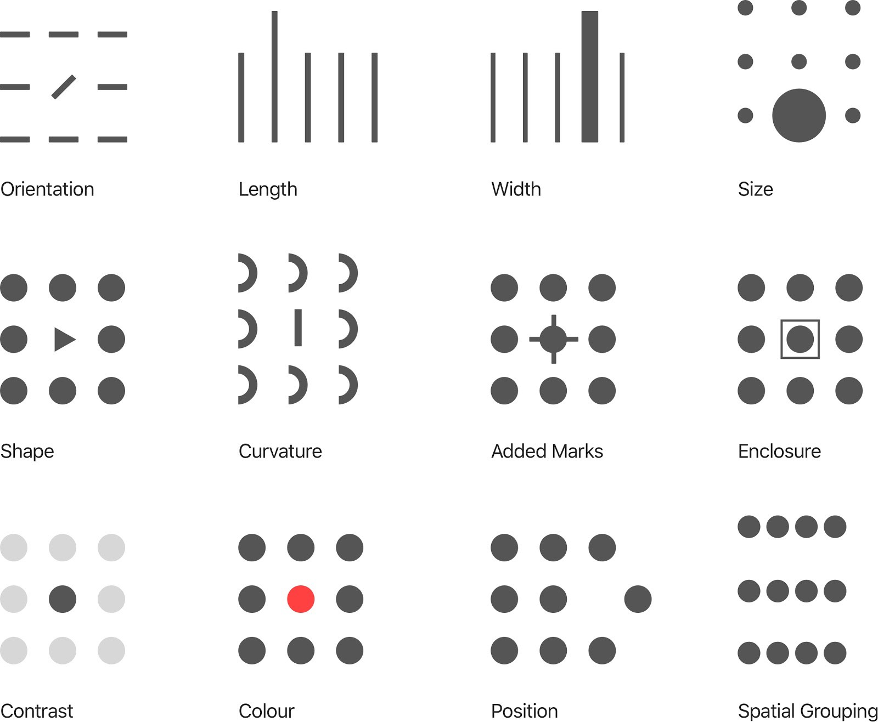

Slide 57


Slide 58
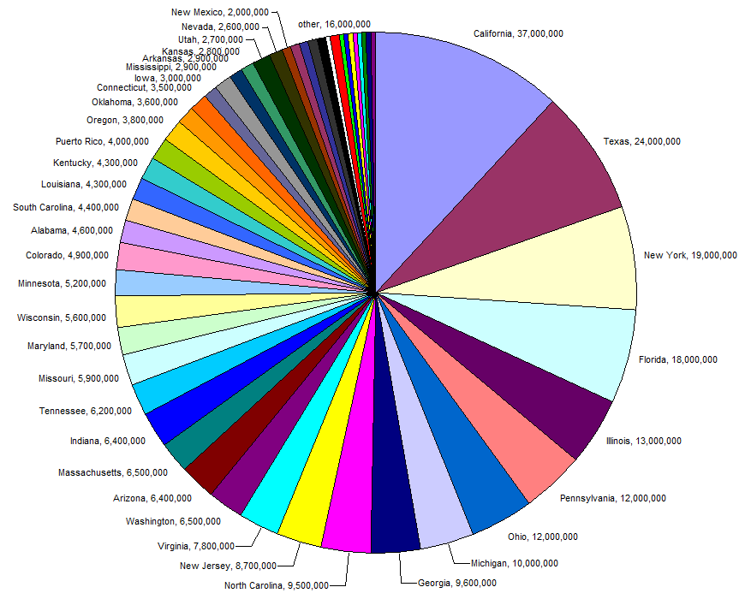
Bad chart choice.

Slide 59
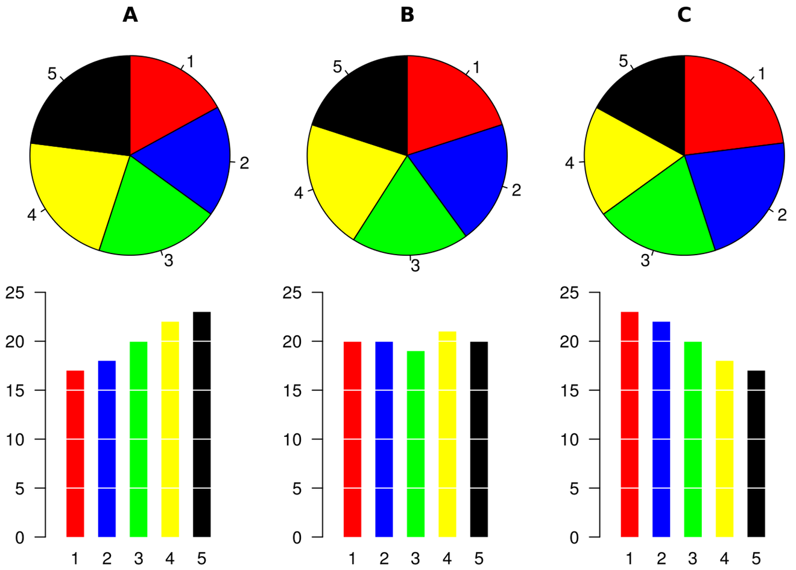
Quickly: What is the largest segment in A, B & C?

Slide 60
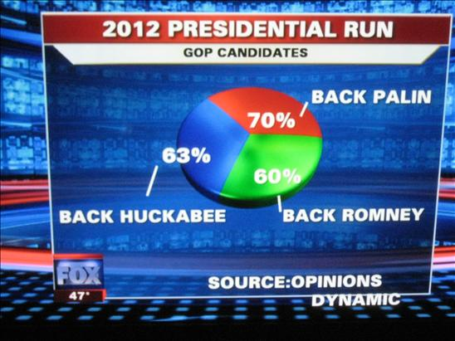
Bad chart data logic.

Slide 61
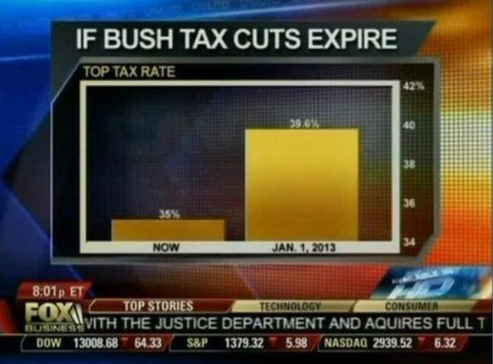
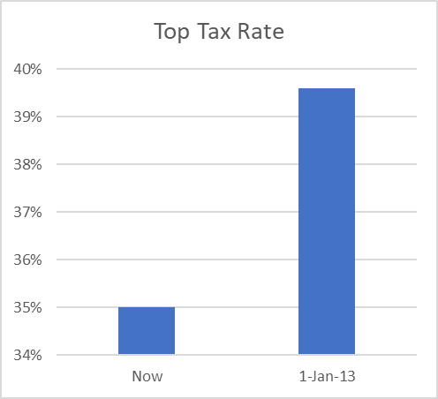
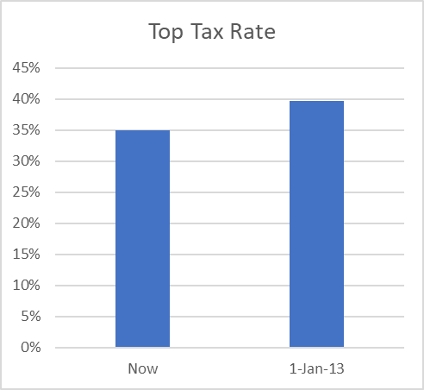
Bad chart intent.
https://www.statisticshowto.datasciencecentral.com/misleading-graphs/

Slide 62
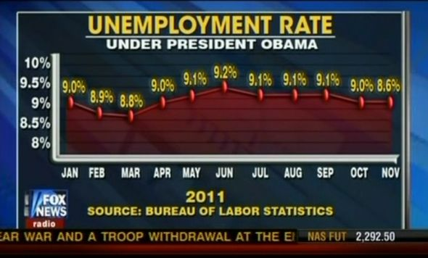
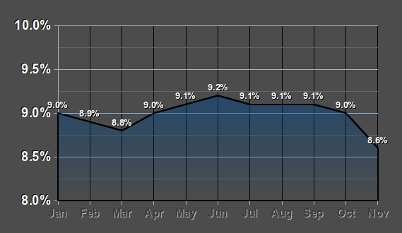
Bad chart intent.
https://www.statisticshowto.datasciencecentral.com/misleading-graphs/

Slide 63
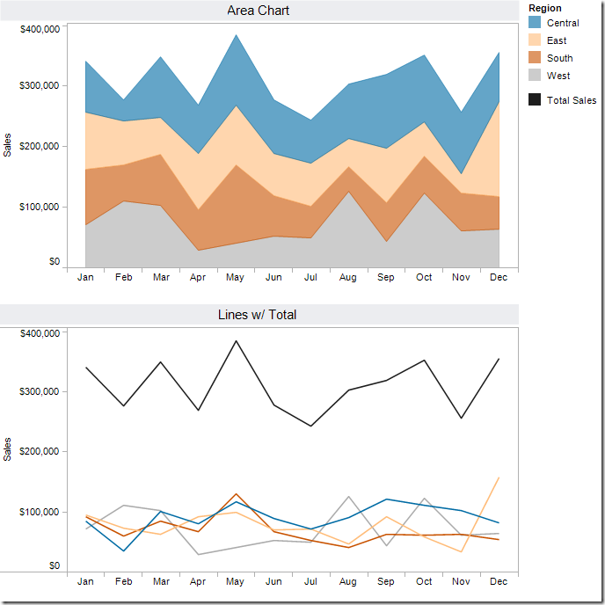
Who had the best May peak?
By how much?
Who had the best Oct peak?

Slide 64
Who had the best May peak?
By how much?
Who had the best Oct peak?

Slide 65
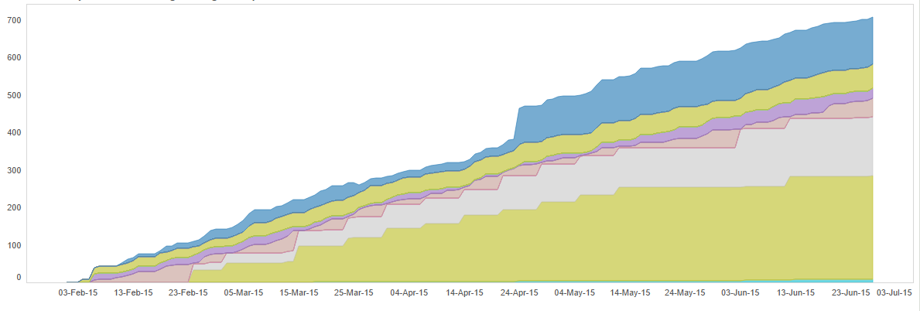
Useful, but only to those who know
Unstable y-axis makes comparing areas difficult
Good if the insight is the top and bottom angle (converging, diverging)
Poor choice is it is about comparing WIP over time

Slide 66
Design charts for INSIGHT
What insight does this chart target?

Slide 67
Design charts for INSIGHT
What insight does this chart target?

Slide 68
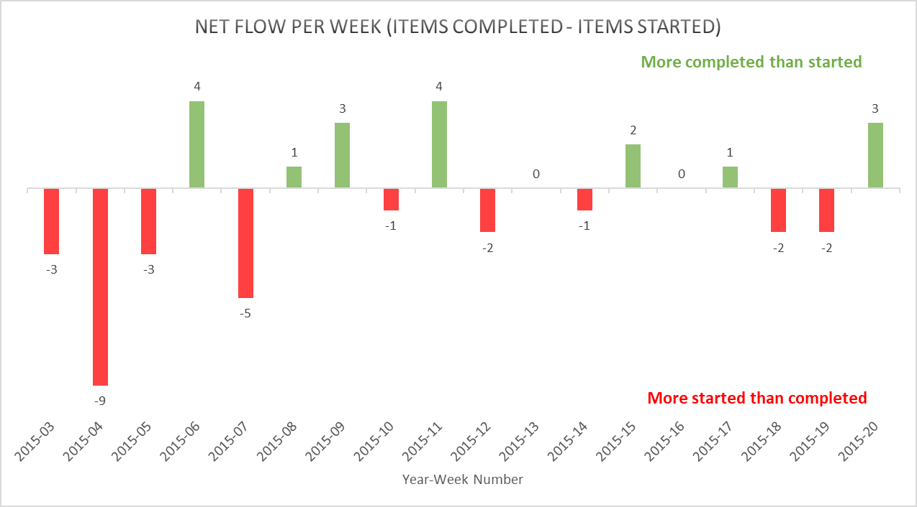
Design charts for INSIGHT
What insight does this chart target?

Slide 69
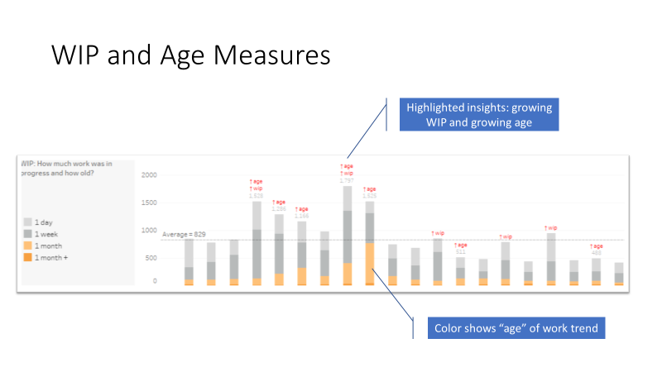
Design charts for INSIGHT
What insight does this chart target?

Slide 70
Simple is better – 6 foot view, 6 inch view

Slide 71
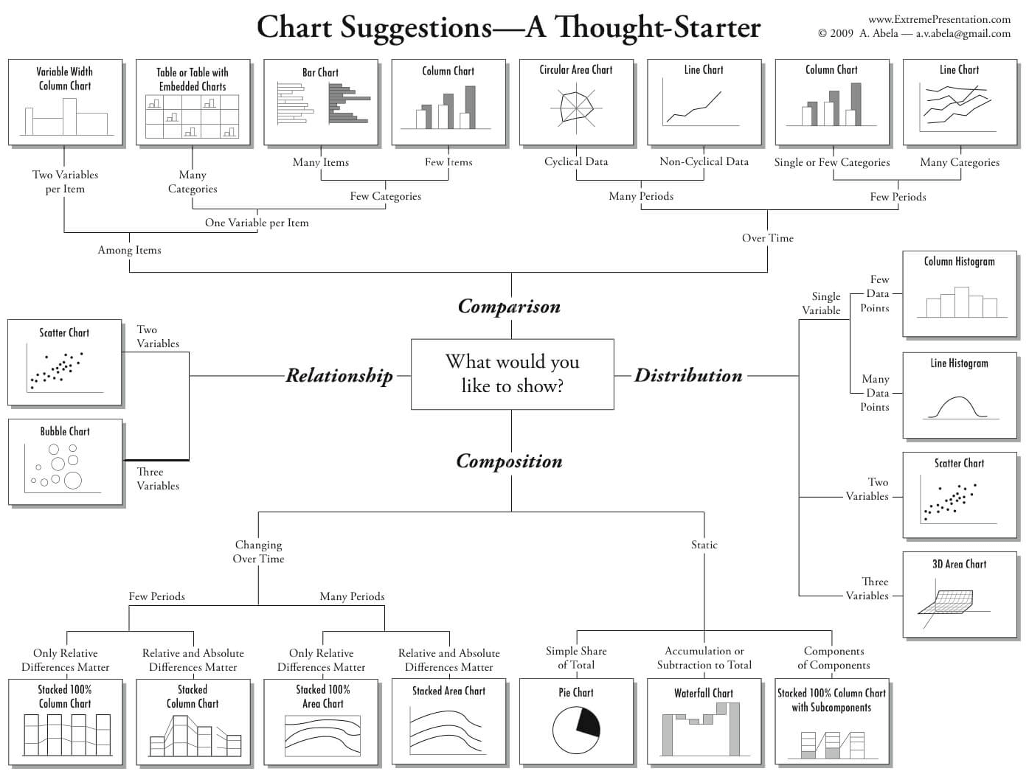

Slide 72
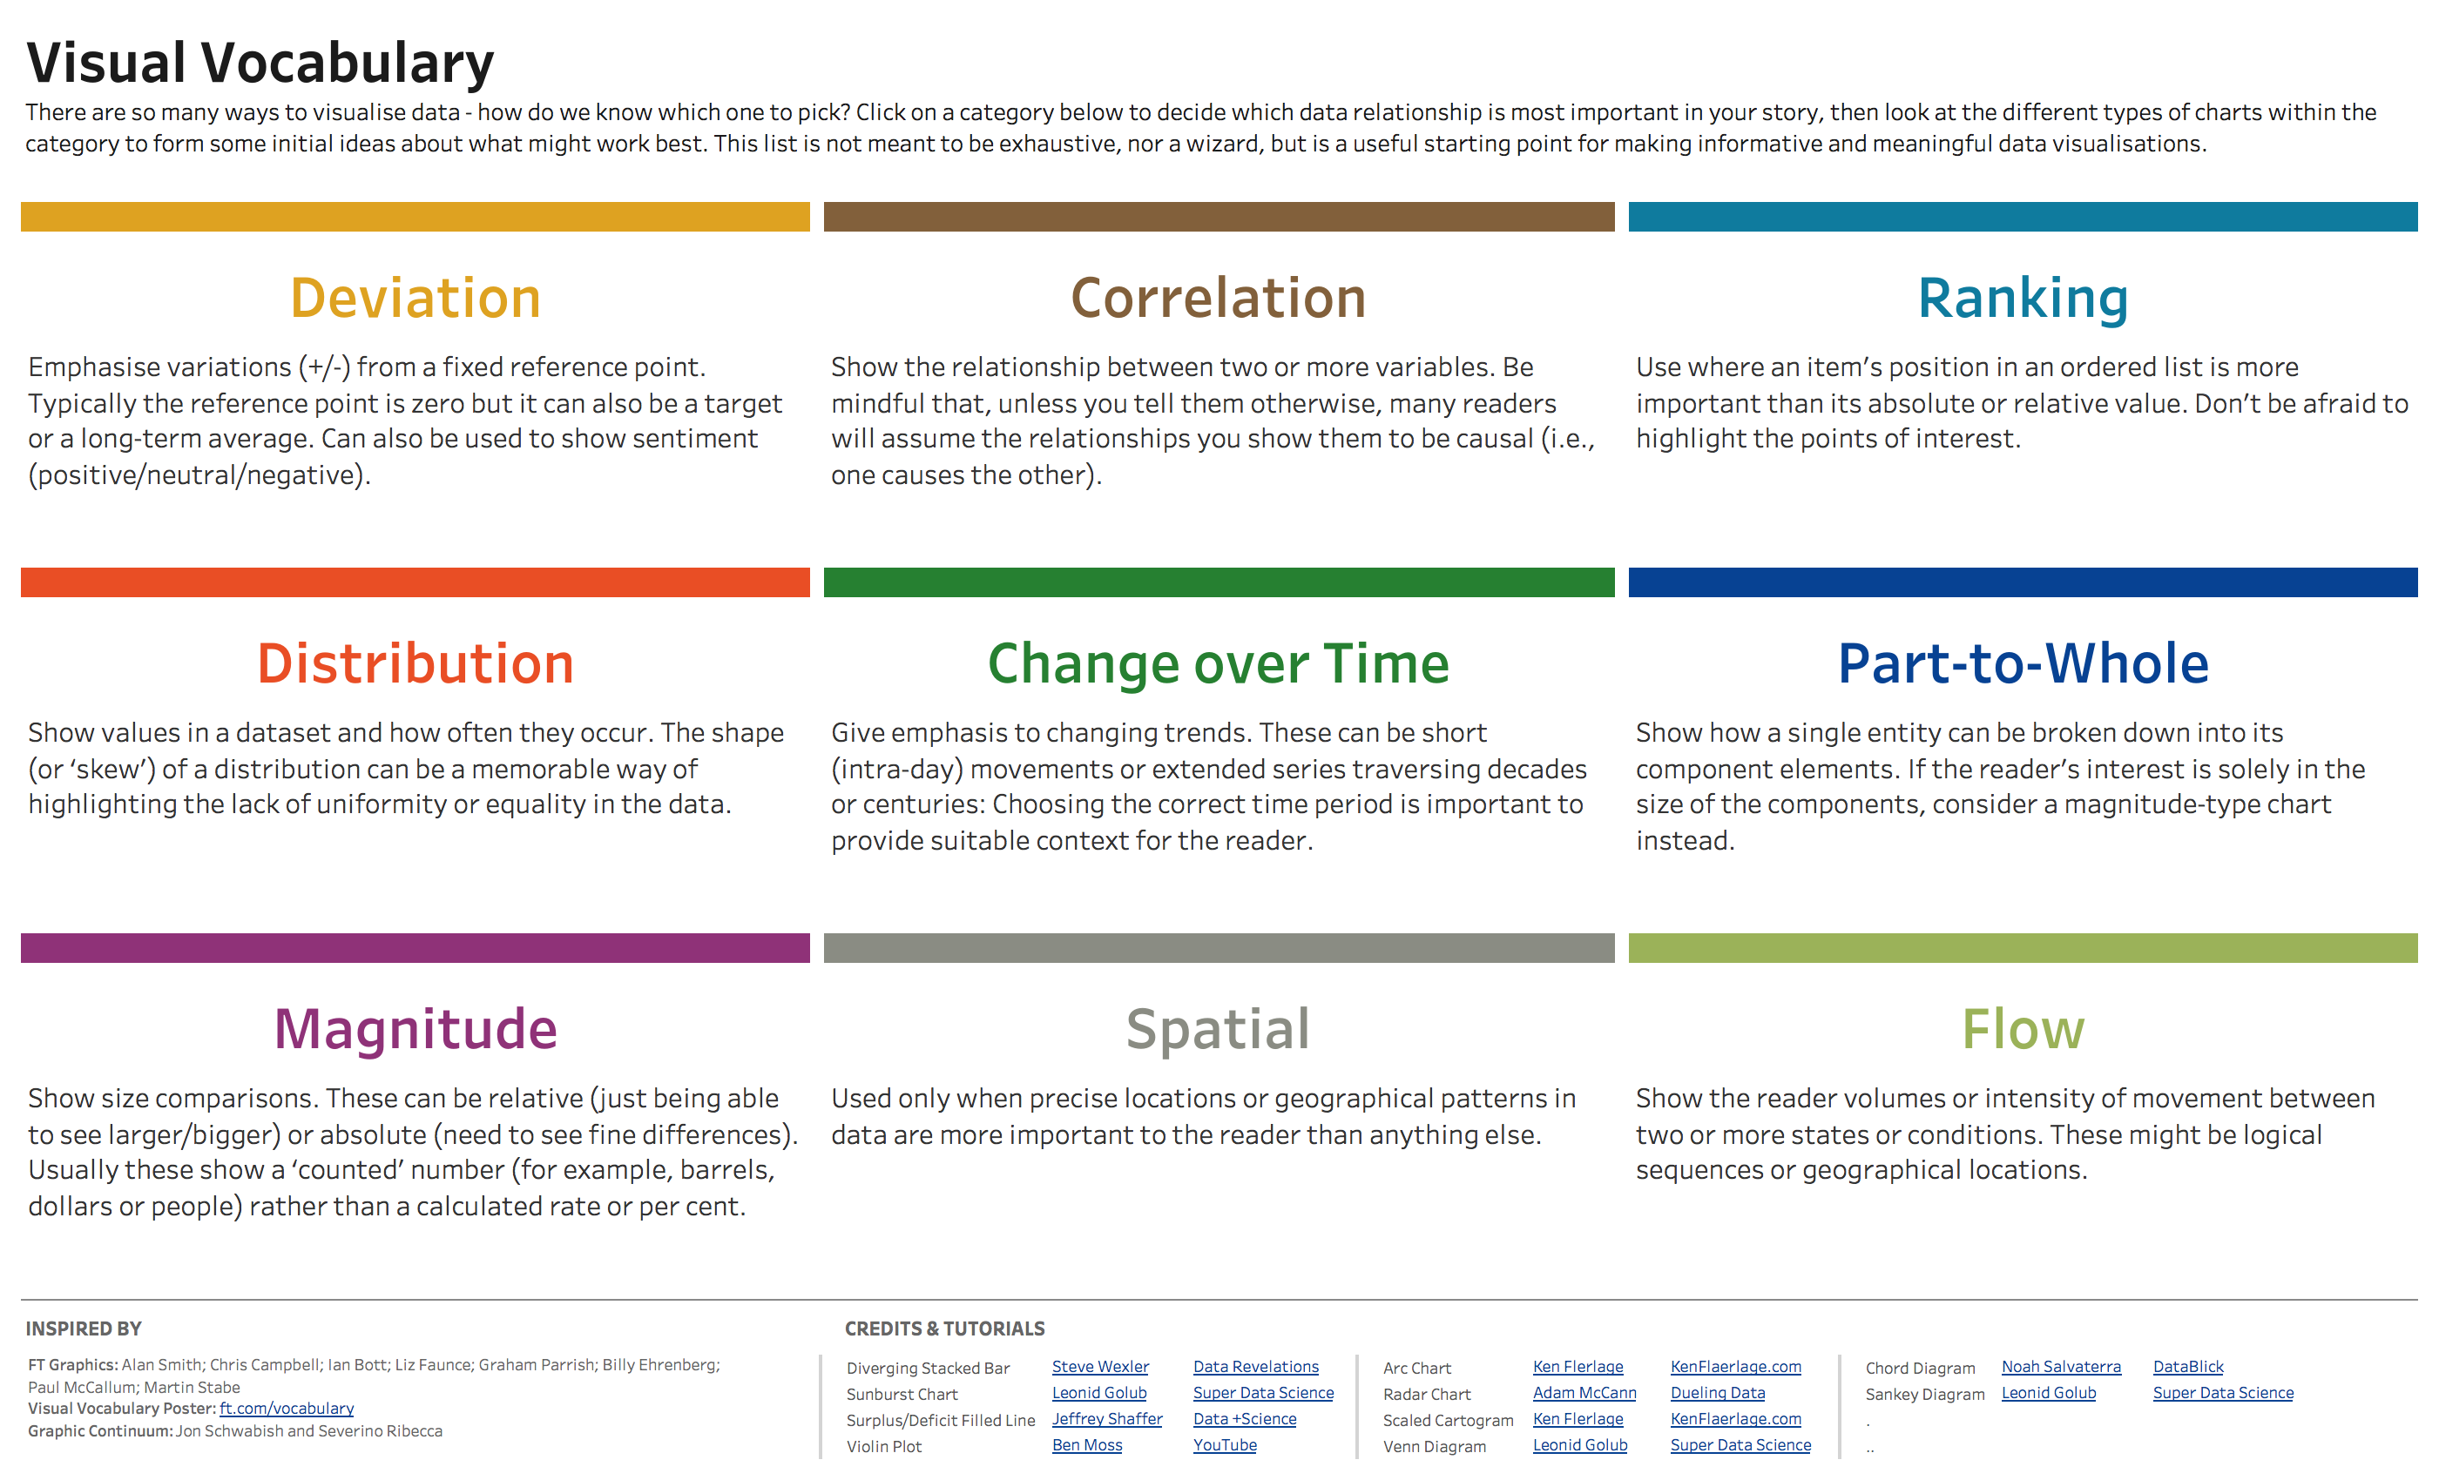
All these images from https://www.vizwiz.com/2018/07/visual-vocabulary.html
https://photos.google.com/share/AF1QipOsge9krcbmO5qj6mzjFbG4WfUL6jYVayXTqBO_BclqUEB94mZrWw-E9-o-Q_pHMQ?key=Tk04RW9oVDZxcC05UEIzRTRYcVJqeXNjb1o4NFpn

Slide 73
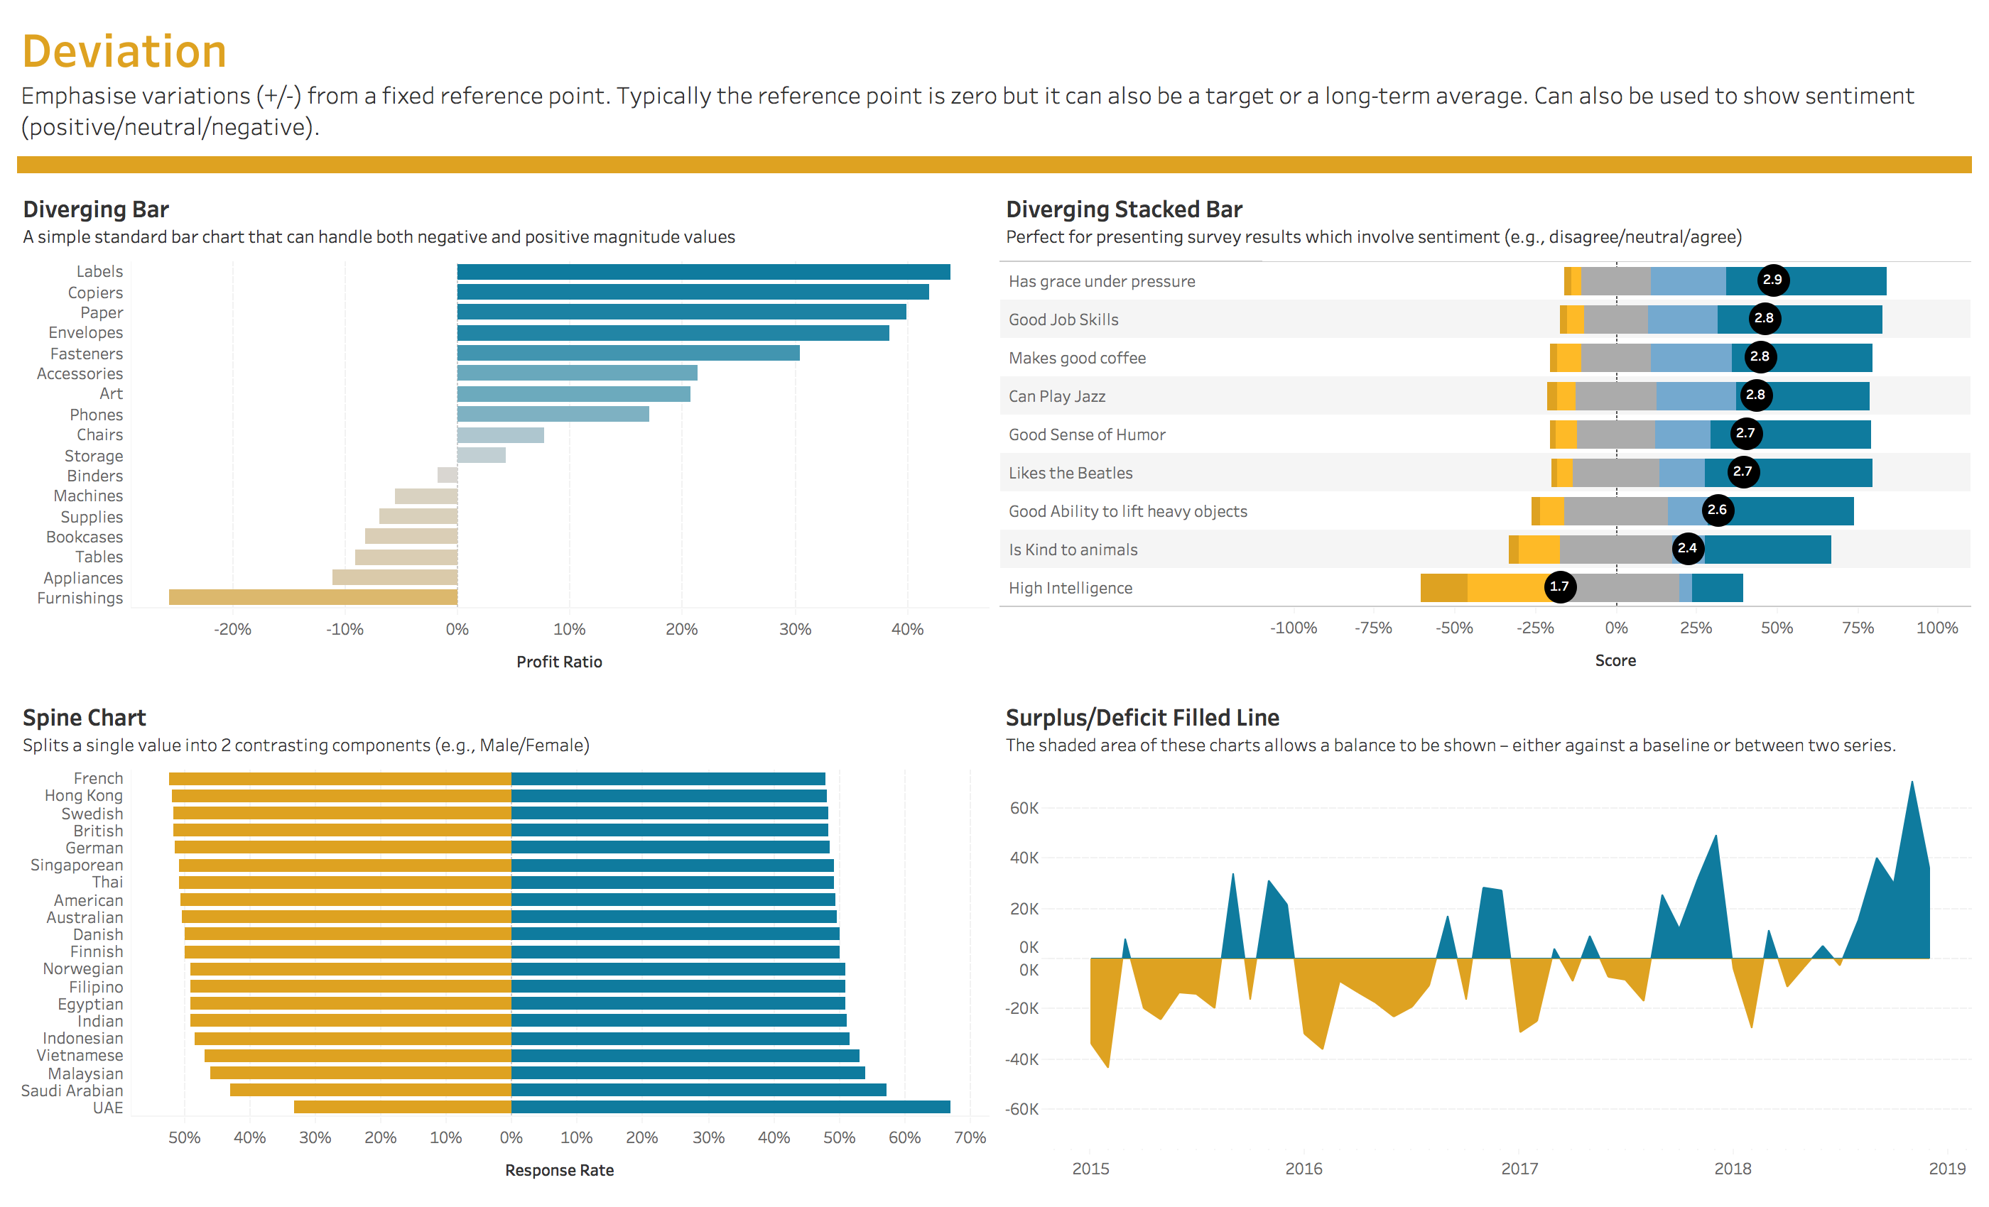

Slide 74
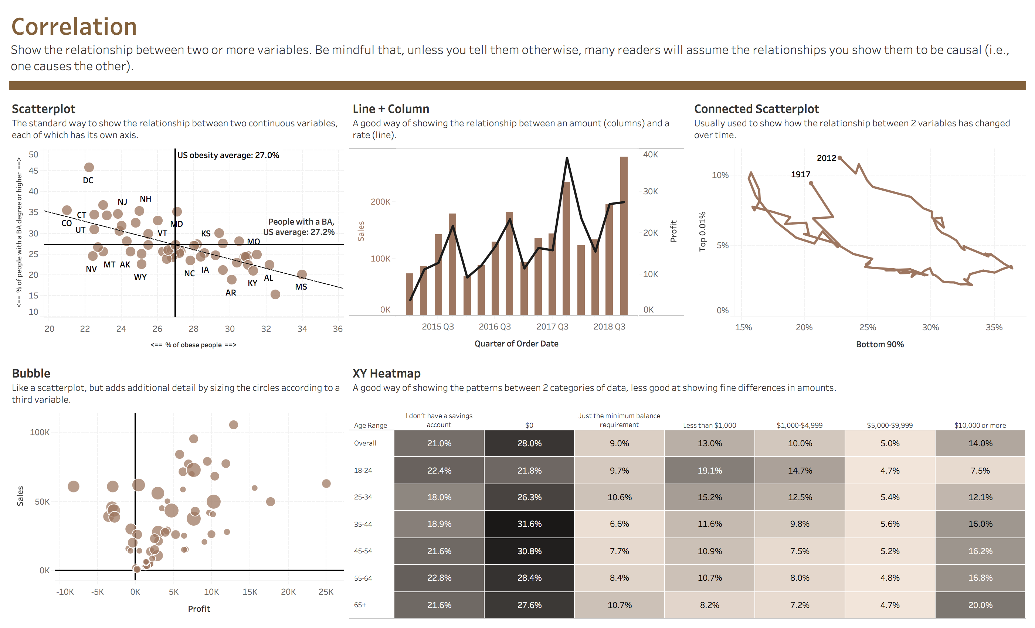

Slide 75
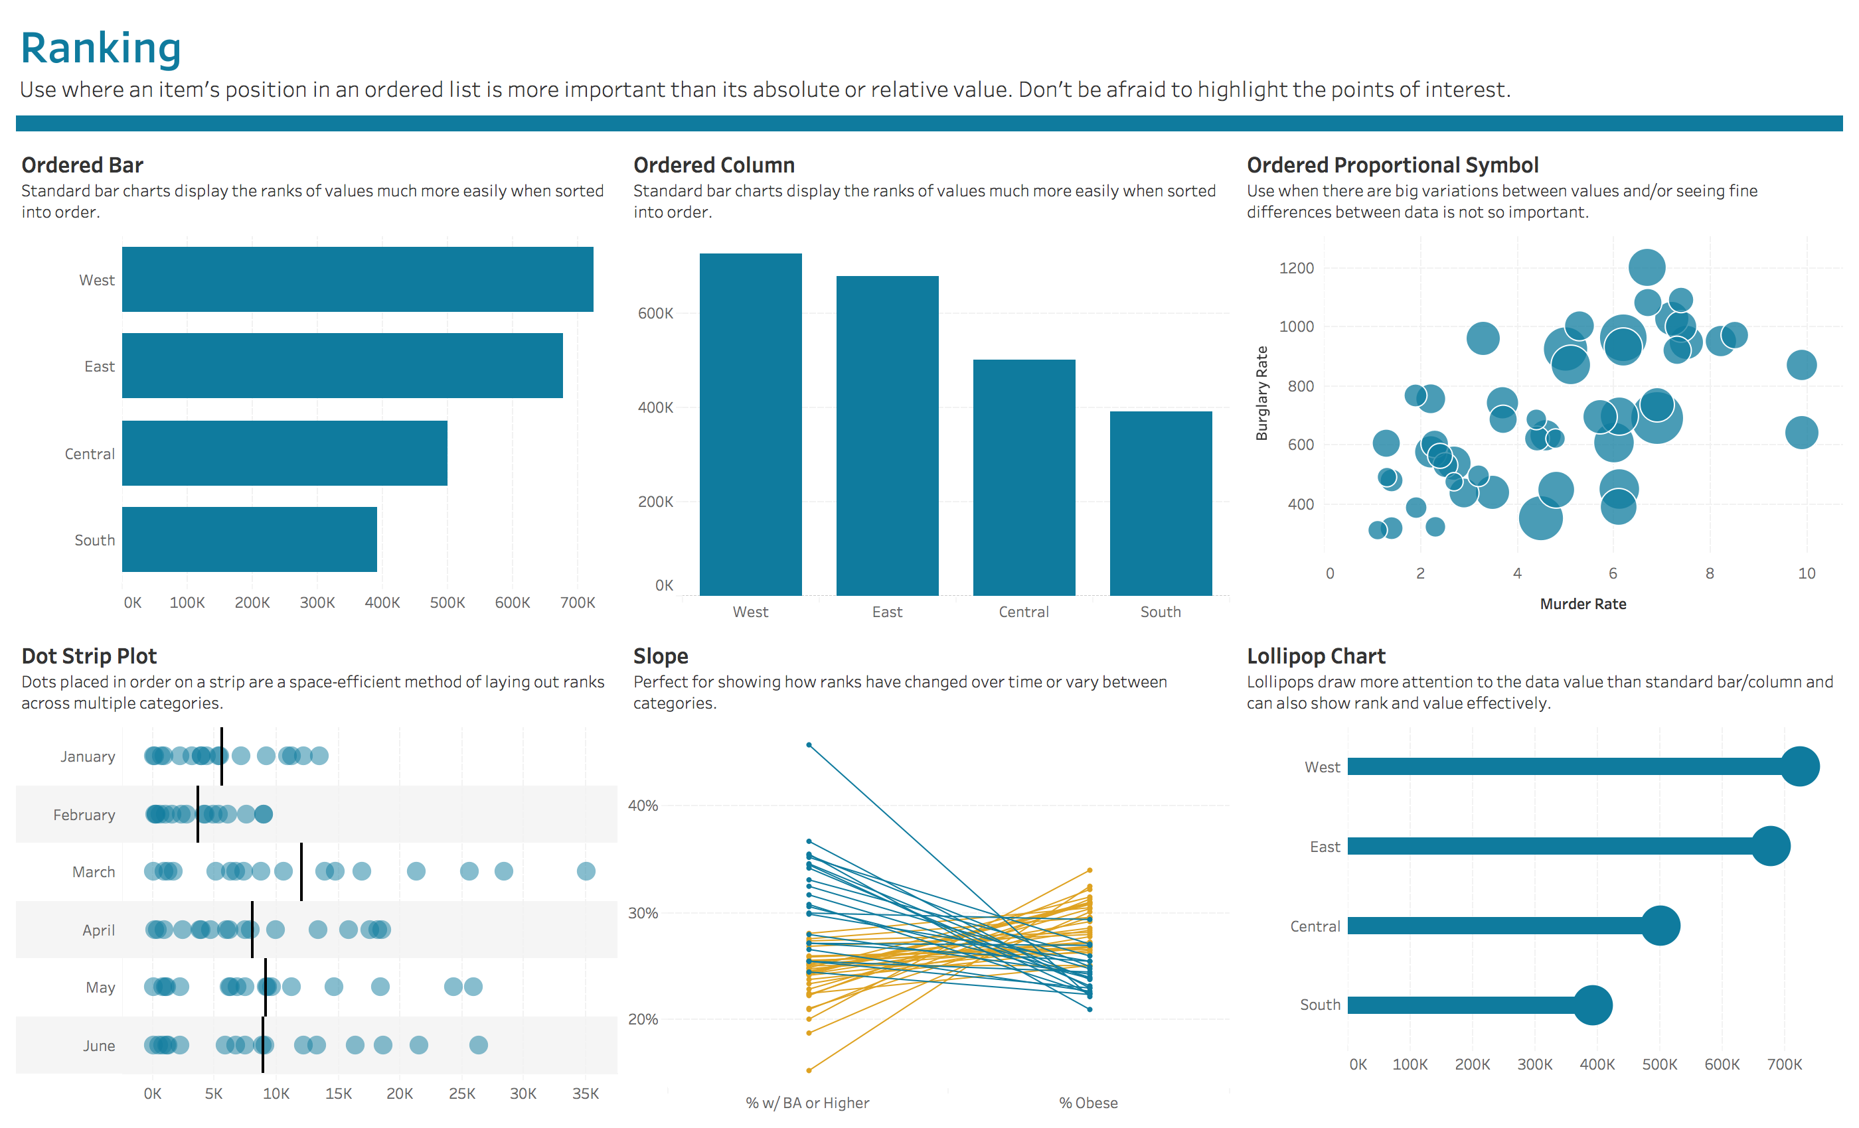

Slide 76
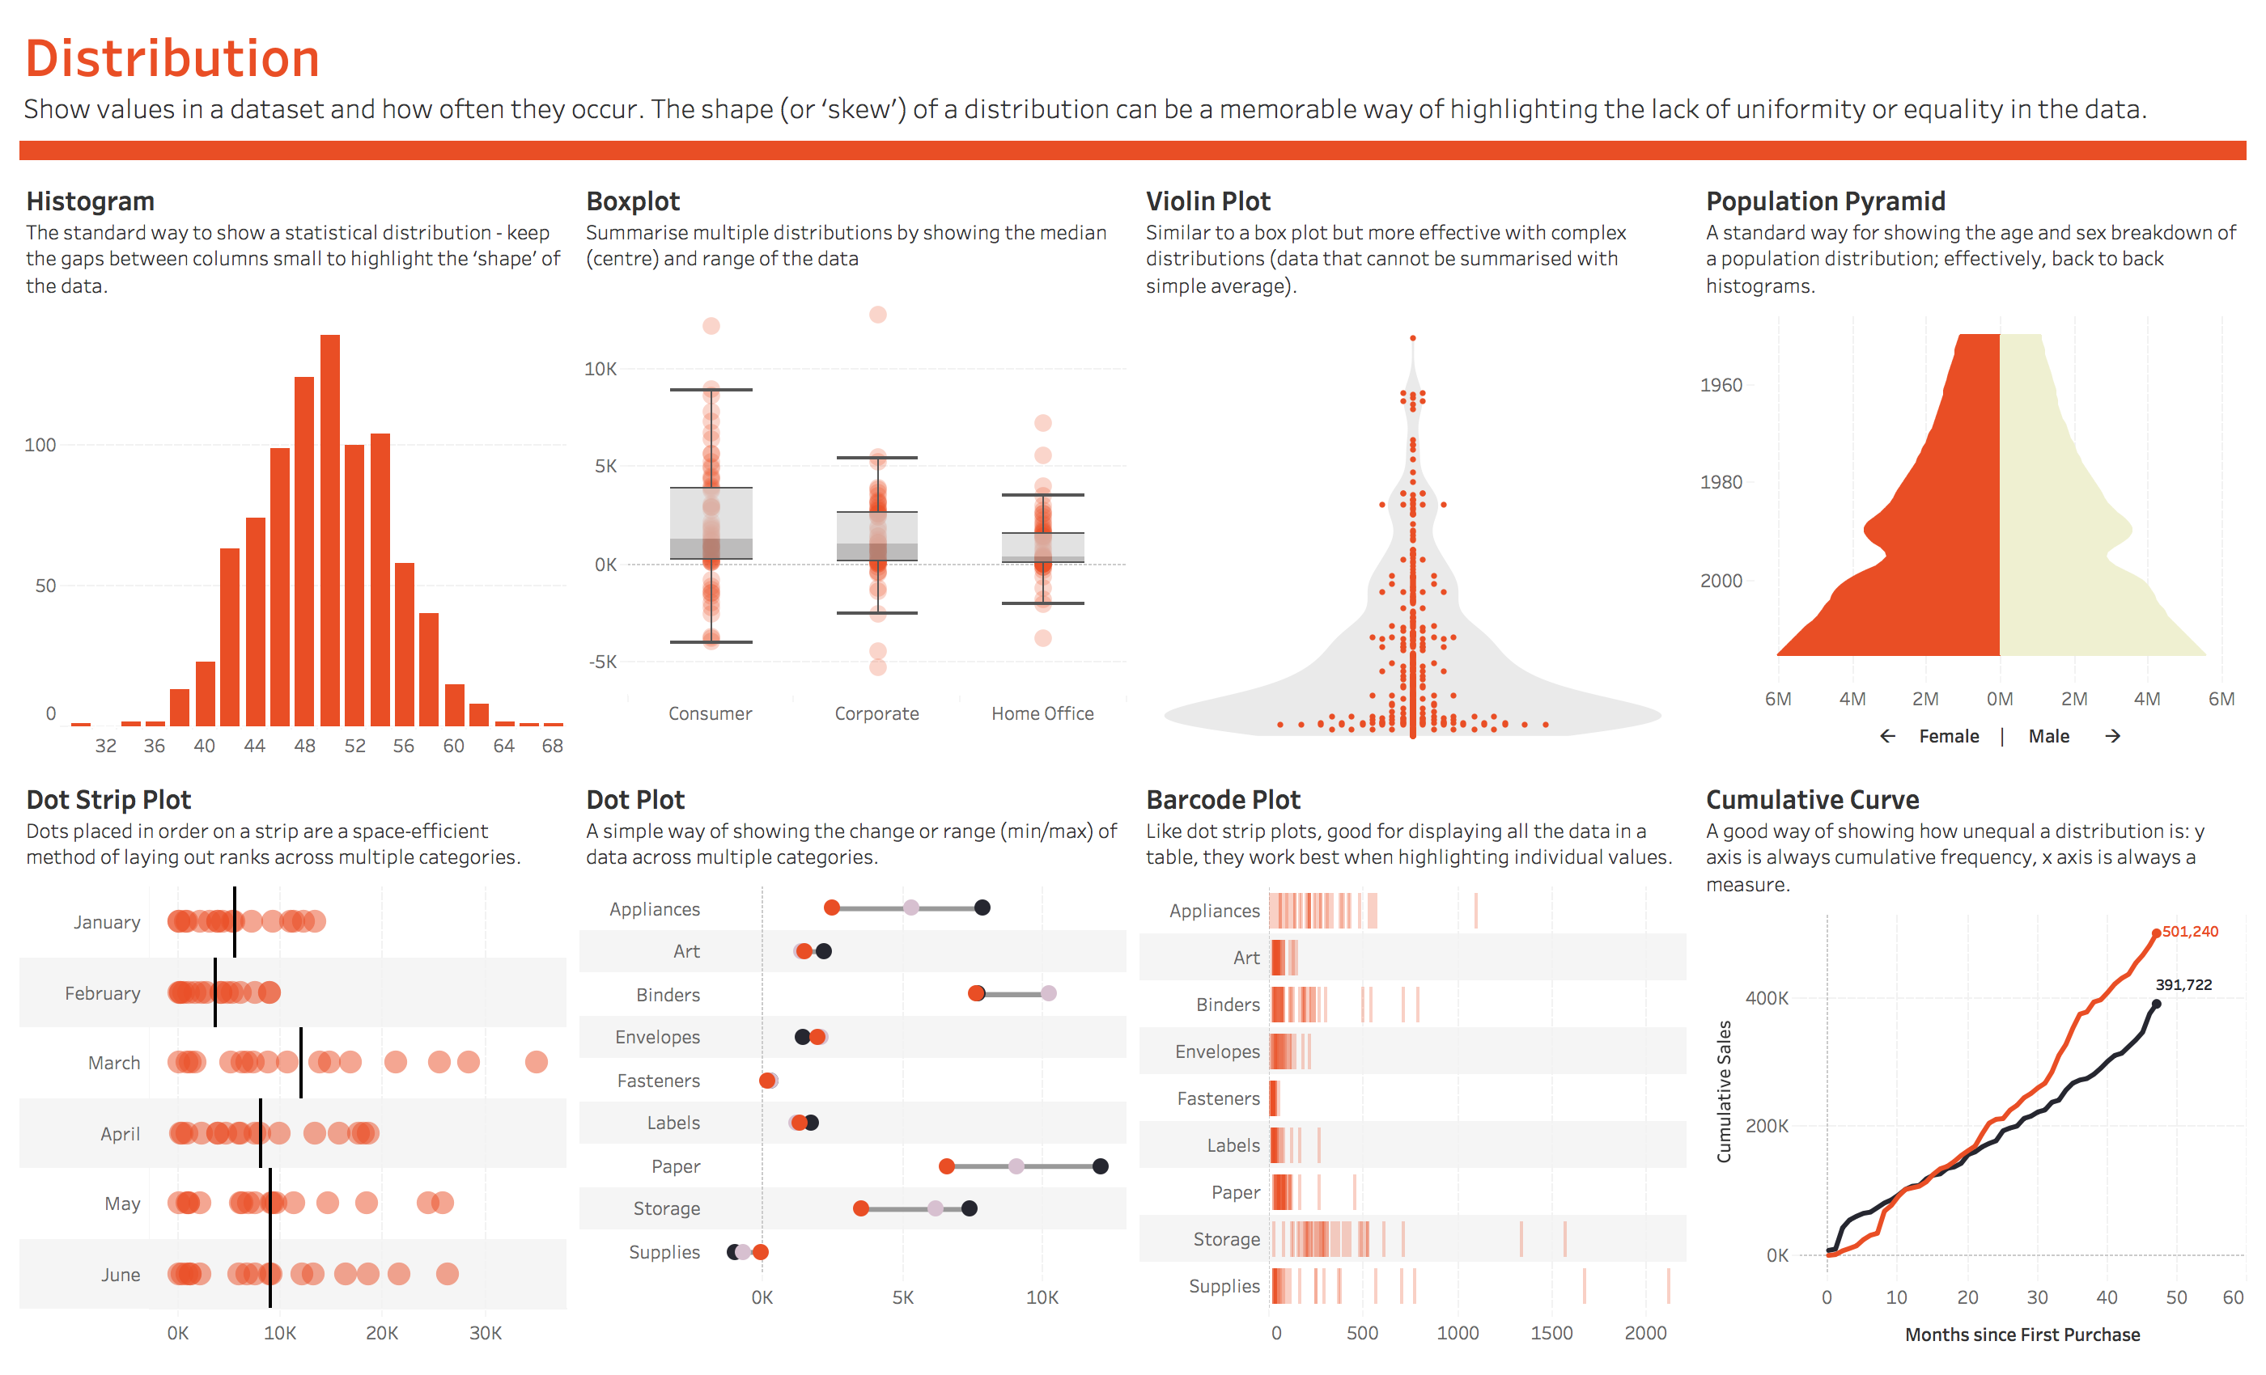

Slide 77
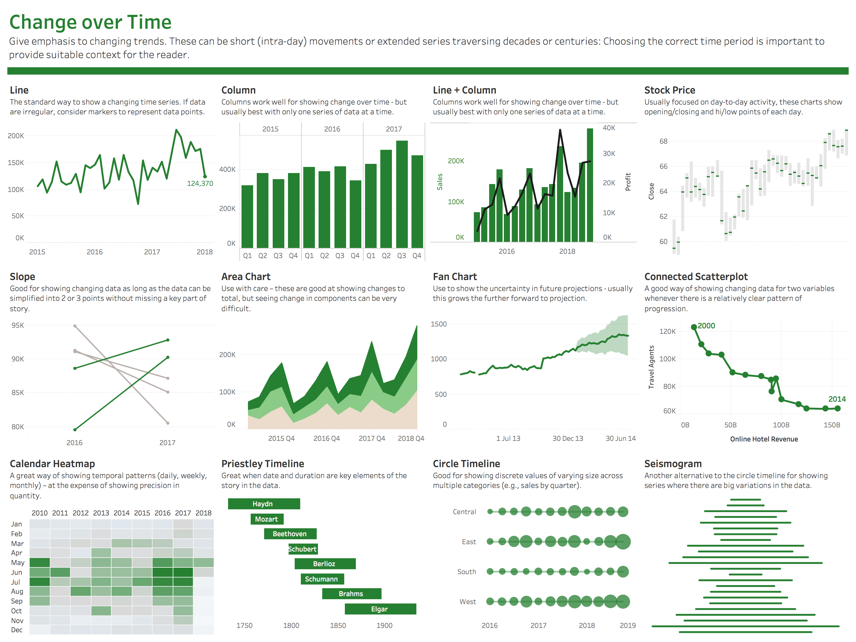

Slide 78
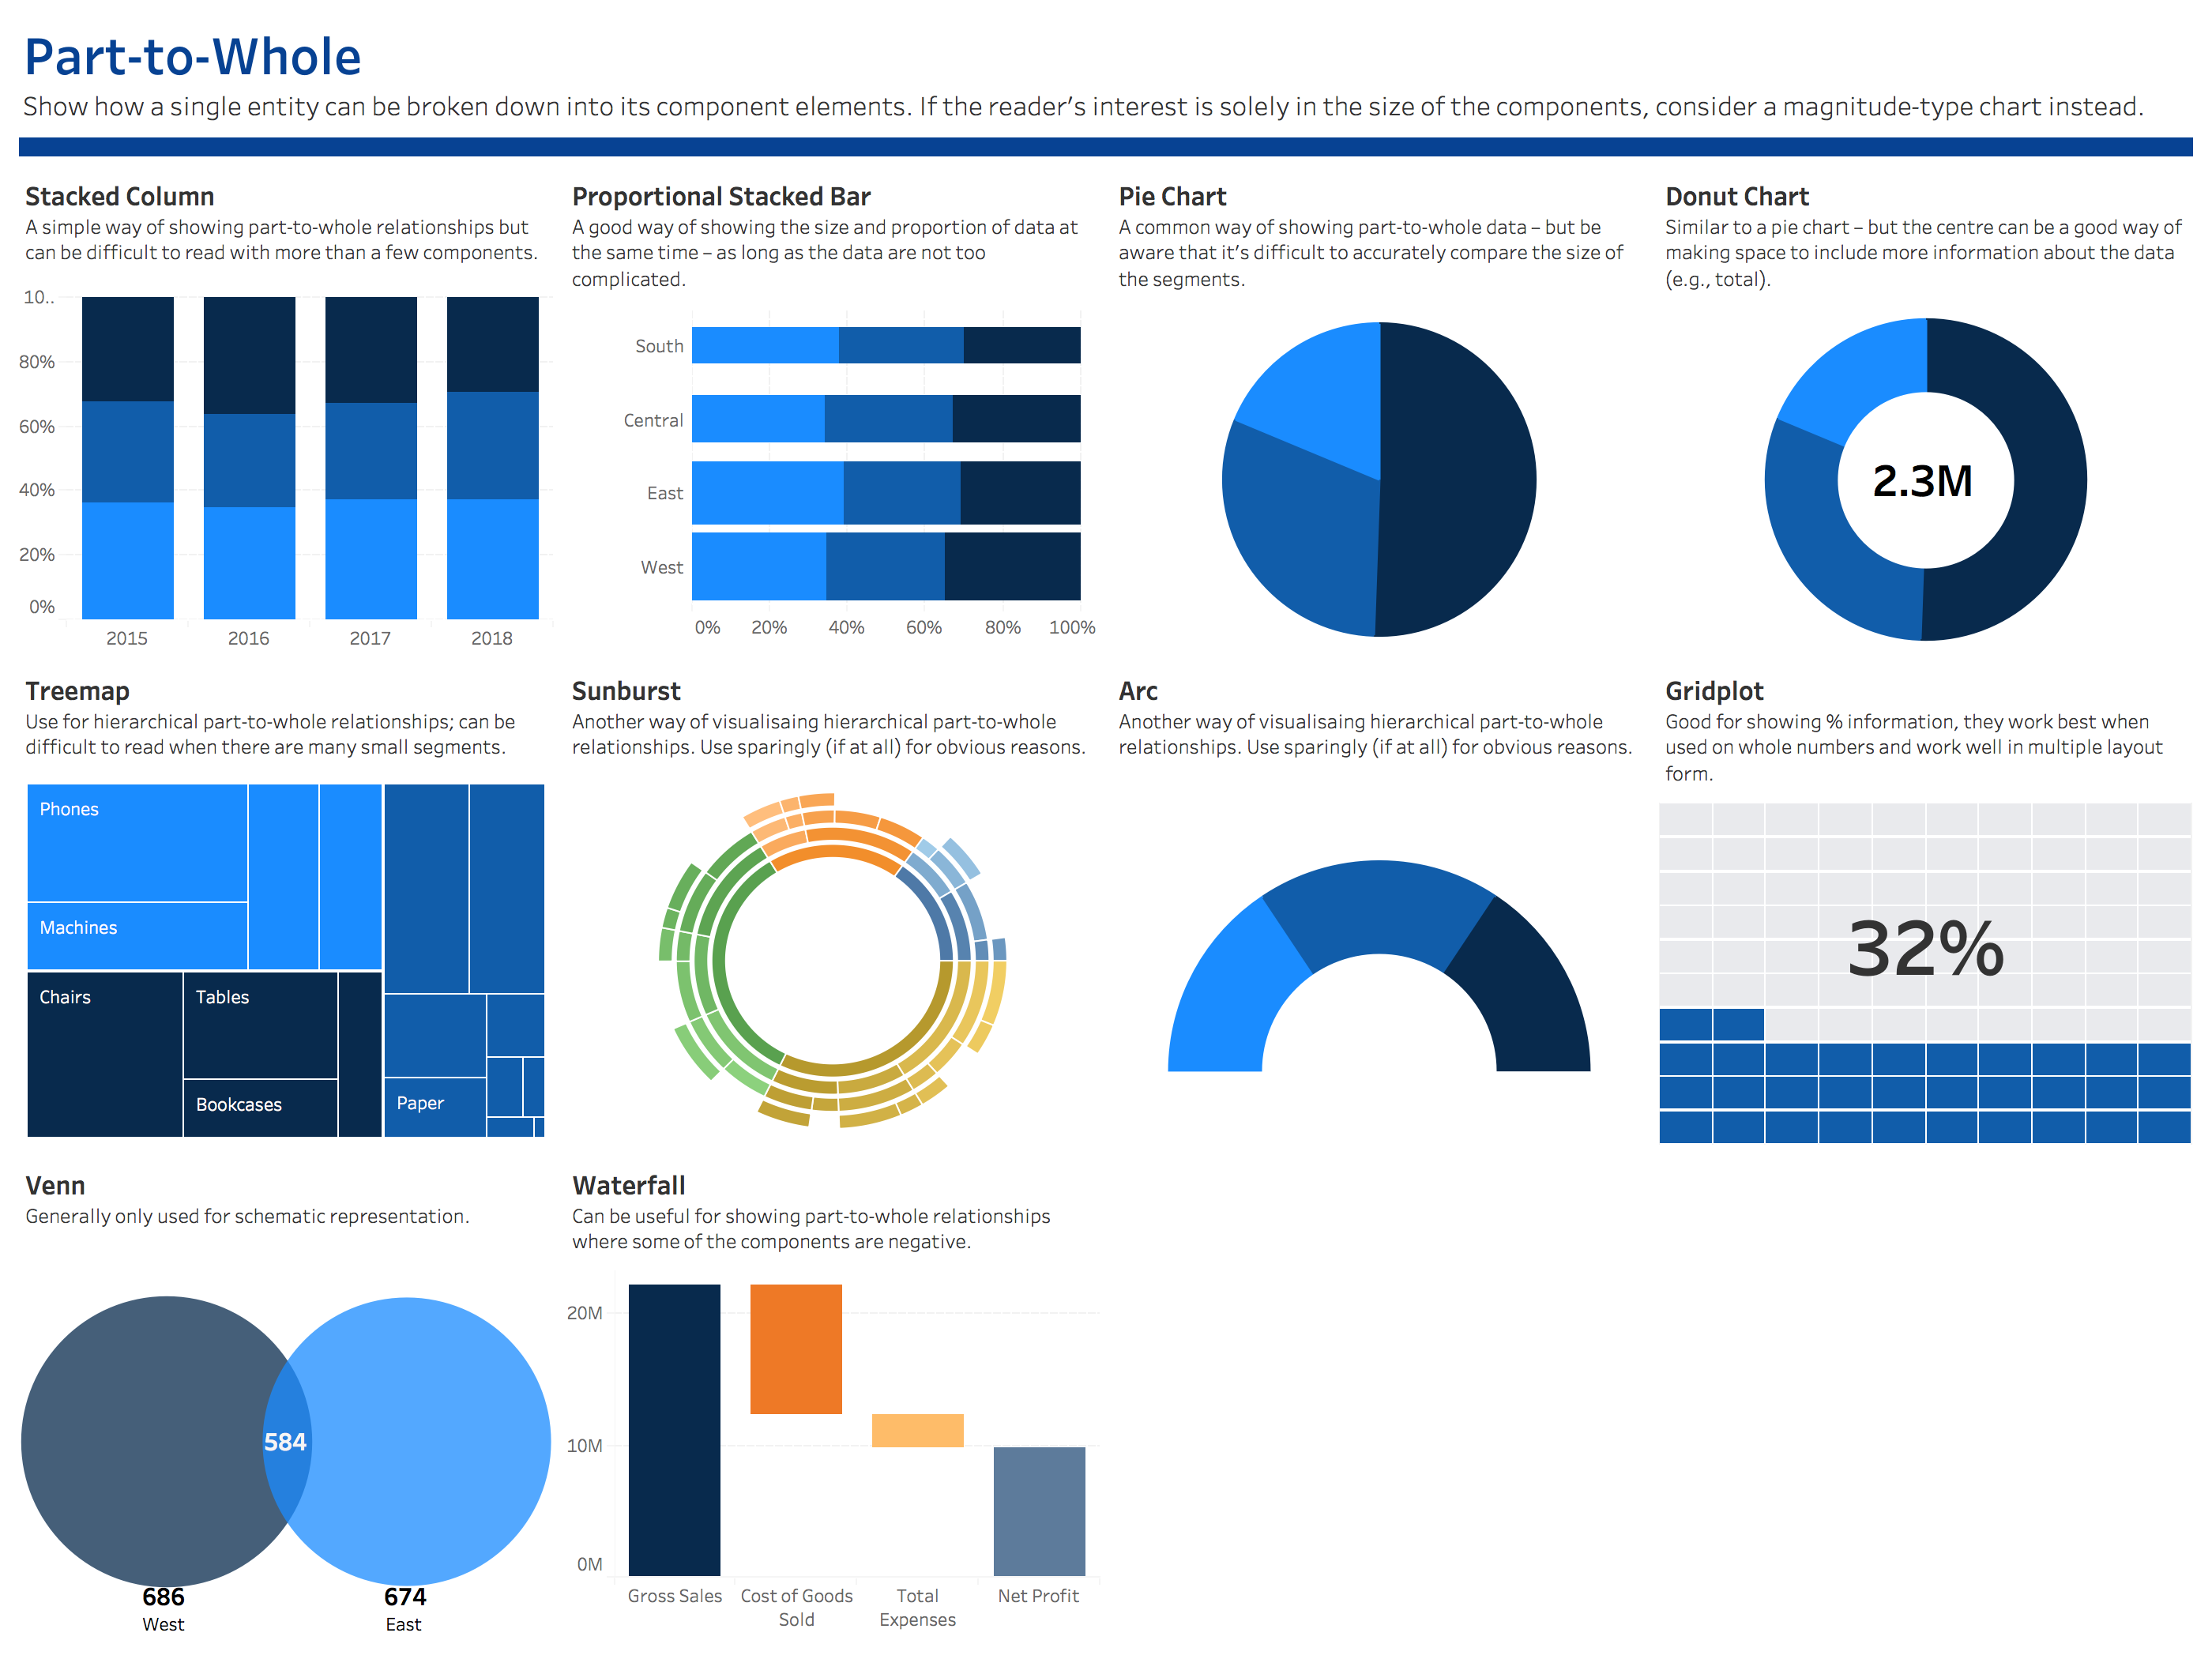

Slide 79
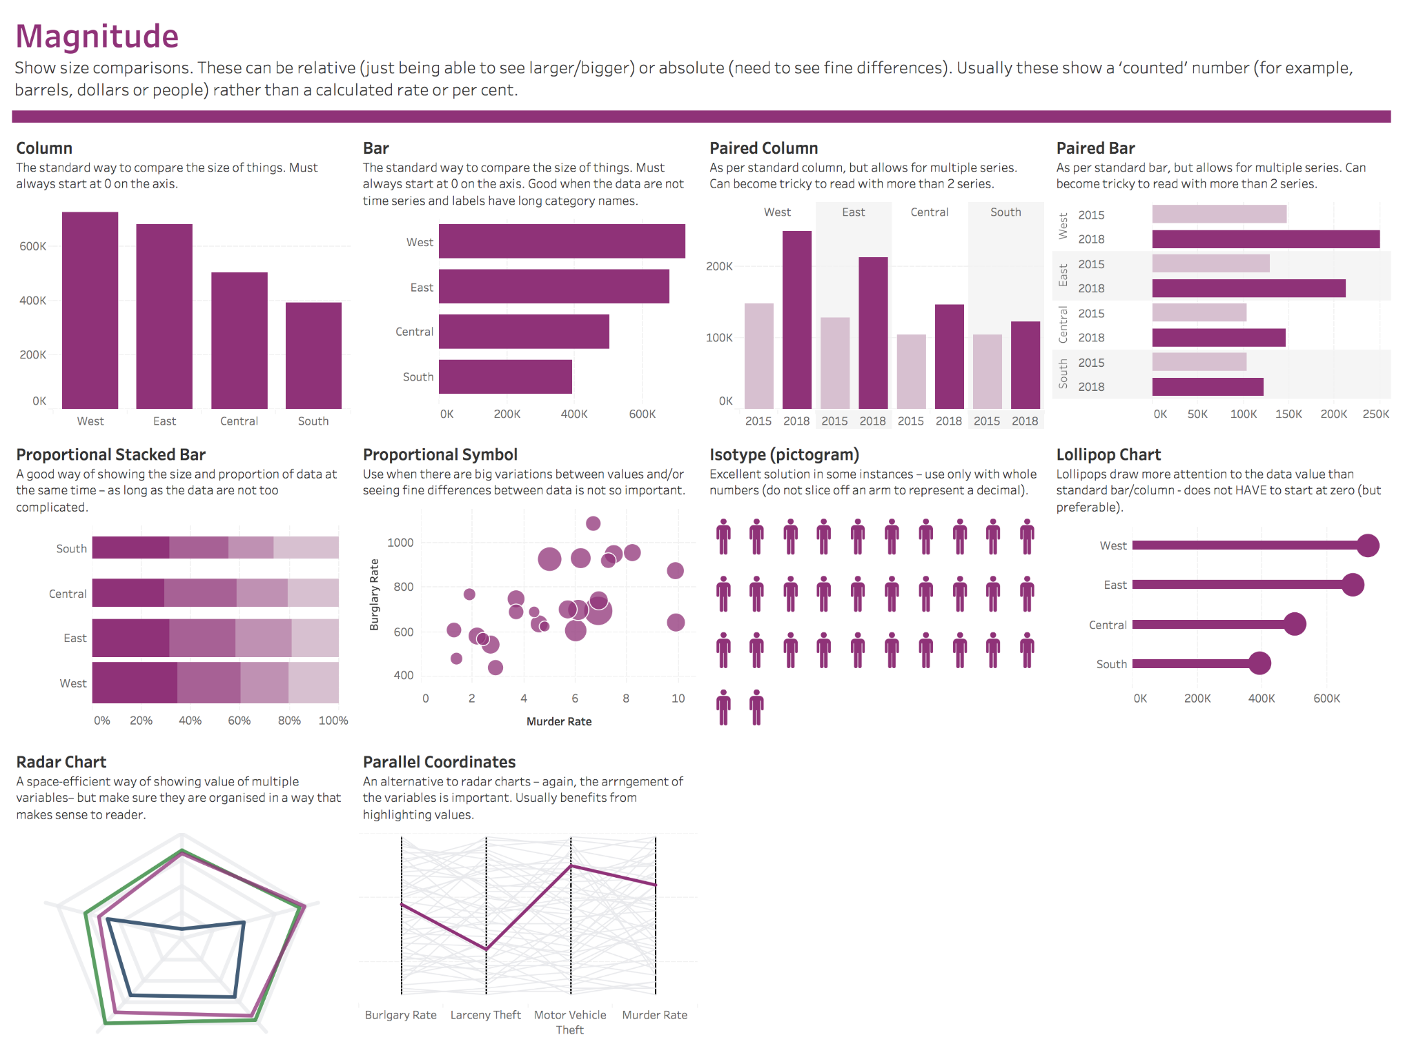

Slide 80
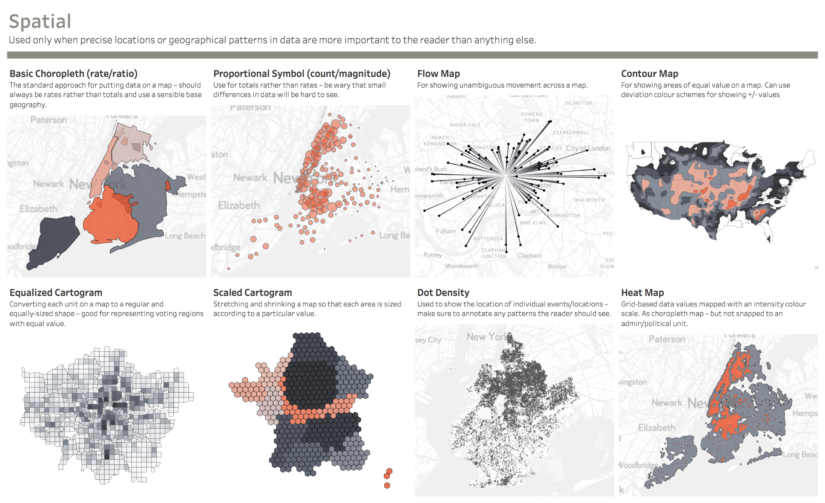

Slide 81
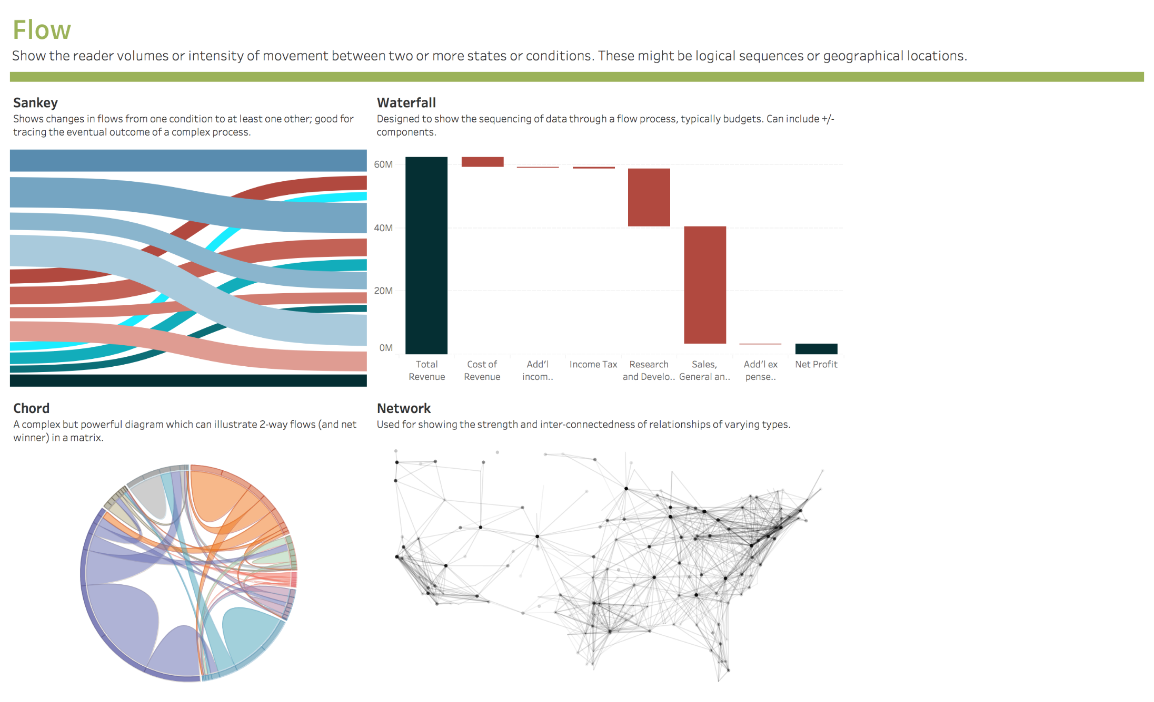

Slide 82
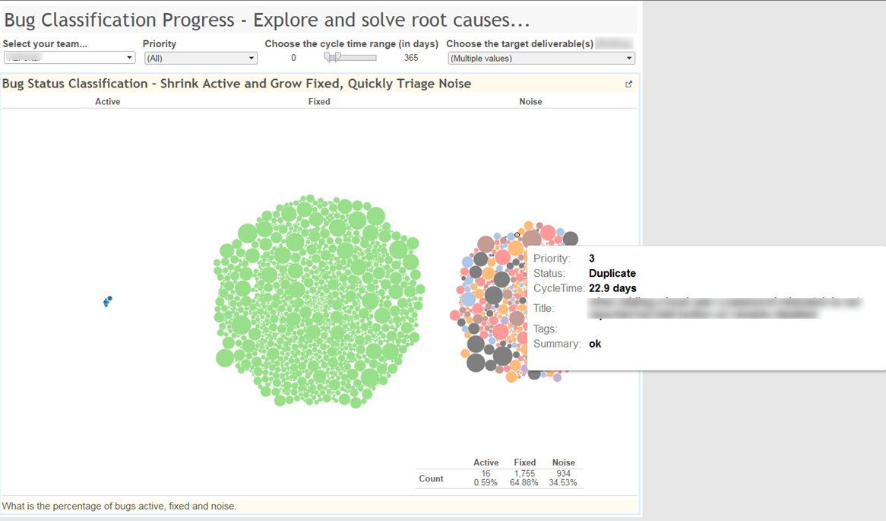
Teams naturally sampled the dots and discussed improvements
Interactivity invites exploration
Violates everything I said about self standing charts. But this is eye candy to invite exploration.

Slide 83
Outcome Driven Metrics
Using O.D.I.M. to drive dashboard design

Slide 85
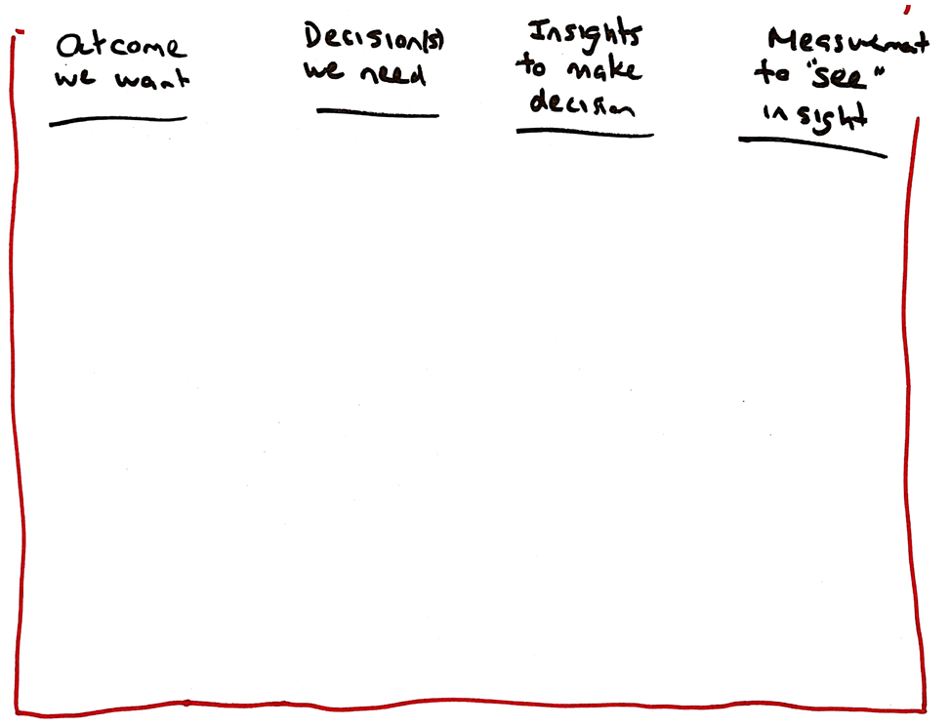

Slide 86
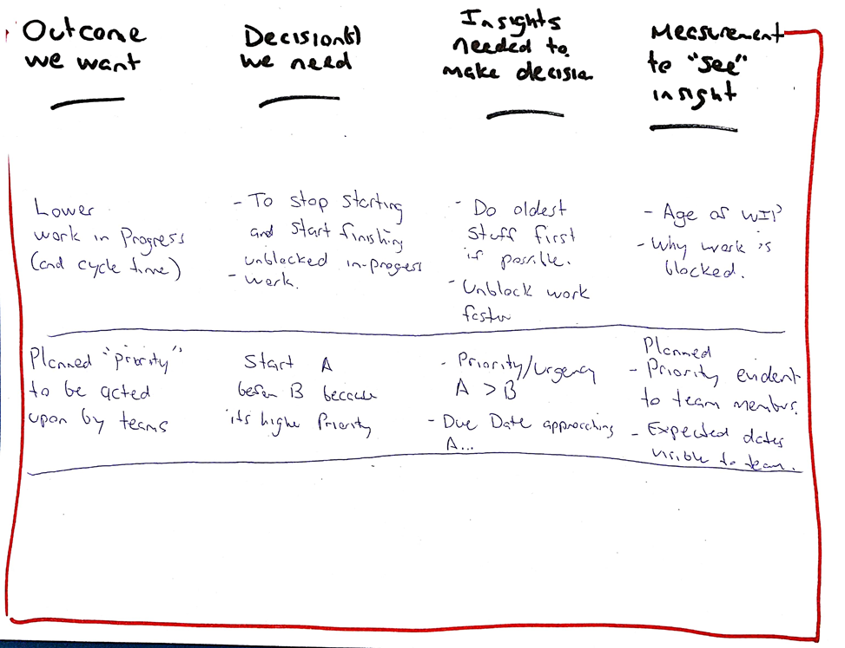

Slide 87
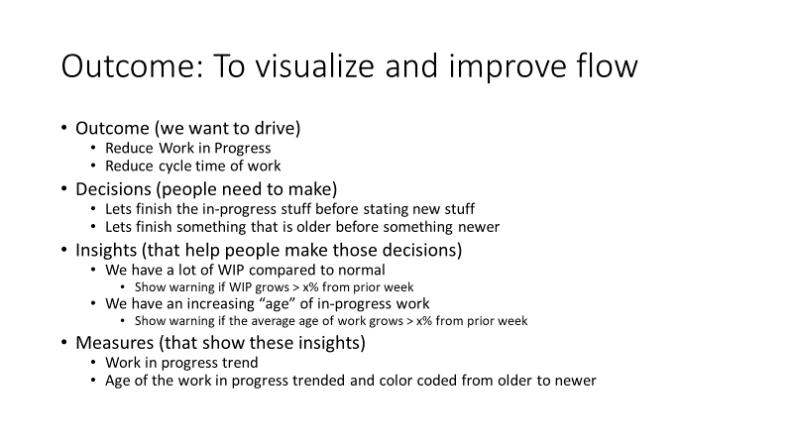

Slide 88
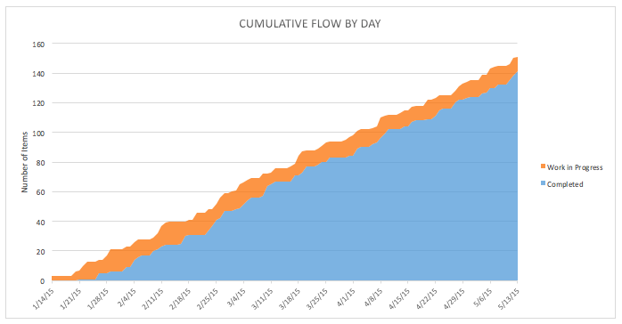


You can tell long term, but NOT actionable short term
Images almost certainly copyright by someone else. But ANY cumulative flow diagram will be similar

Slide 90


Slide 91


Slide 92


Slide 93


Slide 94


Slide 95
Exercise: O.D.I.M. (1 hour)
Goal
To learn how to design dashboards using the ODIM process to support a desired outcome and decision criteria
How
In groups
Decide on an outcome that you want to solve, e.g. “To start the right work”
List a set of decisions needed to further this outcome
List the insights that would be needed to make those decisions
Sketch a few chart ideas (tip: remember to look at the chart selection pages for ideas)
Debrief
Gallery walk – get someone from your group to show your charts and discuss
Which step was hardest for your group to agree on?

Slide 96
BREAK – 15 minutes
Restarting:

Slide 97
Team Flow Metrics

Slide 98


Slide 99
5 Basic Metric Rules
RESPECT INDIVIDUAL SAFETY
SHOW TRENDS
COMPARE DATA IN CONTEXT
SHOW UNUSUAL CLEARLY
BALANCED – AVOID OVER FOCUSING
What are the impacts of NOT following these rules?

Slide 100


Slide 101
Which ones do you track now?
Which ones are hardest to gather?

Slide 102

Caused (littles law)
High defect period caused +WIP
+WIP causing this trend
Always Show together. Discuss Leading Patterns and Mitigation

Slide 103

Target one metric for improvement each season
Responsiveness
Quality
Predictability
Performance

Slide 104

DEMO and Discussion

Slide 105
Exercise: Metric Selection and Tradeoffs (10 mins)
Goal
To talk about the tradeoffs in overdriving a chosen metric dimension
How
In groups, thinks about the four core performance metrics and answer the sentences for the worksheets on pages 22 and 23 of your workbook
Debrief
Which dimension was hardest to determine a metric?
Which dimension was the most brittle to tampering elsewhere?

Slide 106
Trend Based Coaching / Comparing Teams
Oh my …..

Slide 107
Trend Based Coaching
Two step process
Is there an issue impacting everyone or just you?
How severe is the issue and how urgent is solving it?
If it’s a system issue
No single team likely able to solve alone, so don’t frustrate them by asking.
If a few teams bucking that trend, what are they doing that could help others?
If it is a local issue
It is likely some local context. What is different about your team vs other?
Look for teams in similar context but doing well for ideas and help.

Slide 108
If you have this

Slide 109

Everyone is doing more defects, not just this team

Slide 110

No axis values
Subdued line chart so you can see variability
Normalized around average to focus on gradient
You vs Others

Slide 111
Is it a System or Local Issue?
Rule: Don’t challenge teams to improve a system performance issue. They can’t alone!
Compare “your” trend versus a larger group of others as a baseline.
Selected Group Trend (You)
Pattern 1
Baseline Improving
Selected Improving
System Improvement
Pattern 2
Baseline Improving
Selected Steady
Local Issue
Pattern 3
Baseline Improving
Selected Declining
Urgent Local Issue
Pattern 4
Baseline Steady
Selected Improving
System Issue
Pattern 5
Baseline Steady
Selected Steady
Steady
Pattern 6
Baseline Steady
Selected Declining
Local Issue
Baseline Group Trend (Others/System)
Pattern 7
Baseline Declining
Selected Improving
Urgent System Issue
Pattern 8
Baseline Declining
Selected Steady
System Issue
Pattern 9
Baseline Declining
Selected Declining
System Issue

Slide 112
FIRST: Better isn’t always higher
For some measures higher is improvement
For some measures lower is improvement
For some measures no change is improvement
For ALL measures improvement changes over time - CONTEXT
Ask in context (for EACH performance measure) -
“For now, what do we expect BETTER to be?” (up, down, level, between)
“How much BETTER is too much, and how might we tell?” (when, until, before)

Slide 113
How Severe is the Local Issue?
1. First Stem Any Declining Dimension
Compare “your” trend decline angle versus a larger group of others as a baseline. Slight declines can be a “watch and see” but jump on Moderates” to avoid ever seeing a “Severe”
2. Then Look to Improve Your Worst
Compare “your” measure of performance against others as a baseline. Pick others in similar context to your team, for example those who do similar work or were formed at a similar time.
Baseline Trend
> ~ 20°
Your Trend
> ~ 20%
Slight
Moderate
Severe
> ~ 45°
> ~ 50%
Note: Being at or above baseline isn’t the ONLY goal. Some teams benefit from being higher in some performance dimensions and trade wisely from another performance dimension to compensate.
Note: Shorter term trends often appear more extreme. If 1 month looks bad, check 3 months still looks bad.

Slide 114
Polarity Coaching

Slide 115


Slide 116
Maximize time here
Maximize time here
Minimize time here
Minimize time here

Slide 117
Deliver value faster
Fewer prod rollbacks
Faster uptake of most recent version
Less tech debt
Release smaller features
Customers get features faster (or bits of)
Talk about valuable small feature deliverables early
Quality Focus
Speed Focus
Longer time to feature deploy
Never-ending testing
Gold plating of edge cases
Features too small to matter
Increased prod rollbacks
Increased tech debt
Don’t deliver anything

Slide 118


Slide 119
Exercise: Early Warning Signs Decreasing Lead-Time Variability (10 minutes)
Goal
To learn how to facilitate getting a set of early warning signs for metrics
How
In groups brainstorm early warning signs for -
TOTAL FOCUS on reducing lead-time variability, at the expense of everything else
TOTAL IGNORANCE on lead-time variability, not even considered a factor
Debrief
What measures would you balance lead-time against?

Slide 120
Exercise: Early Warning Signs WIP measurement (10 mins)
Goal
To learn how to facilitate getting a set of early warning signs for metrics
How
In groups
Early warning signs of TOTAL FOCUS on reducing WIP, at the expense of everything else
Early warning signs of TOTAL IGNORANCE on current WIP, in fact the opposite
Debrief
What measures would you balance WIP against?

Slide 121
2 Minute Challenge
Answer the questions posed in the beginning of the class in 2 minutes

Slide 122
Contacting me…
Troy.Magennis@focusedobjective.com
@t_magennis

Slide 123

Top Three Forecasting Fail Reasons
Reasons you shouldn’t have hired me five years ago

Slide 124
Fail 1: Start Date On-Paper != Reality
Start Date of Feature B is the finish date of Feature A
What is the team doing now?
The assumed Start Date is often ONLY on paper
Define what start means
Team is dedicated and in-place
They are trained and know how to do their work
They know and understand what work they need to deliver
Nothing inhibits them doing or delivering that work
Team is never fully available on day one!

Slide 125
Fail 2: Backlog Rate versus Delivery Rate
Features
Estimated Stories
Implemented Stories and Defects
Feature
1
2
1a
1b
2
3
3a
3b
3c
Feature
1
1a
1b
1
2a
2b
1
2
Feature
2c
Actual Backlog Rate Delivered = 6
Measured Throughput = 12

Slide 126

Fail 2: Backlog Rate versus Delivery Rate
Forecast using the “Completion rate” we may under-forecast
Backlog is Miles per Hour, Completion rate is Kilometers per Hour
Normal split rates are between 1 to 3 times (most common seen)
This means
If you don’t account for it, you will UNDER-FORECAST by 1 to 3 times!

Slide 127


5 X 1.6 = 8
3 X 1.3 = 4
8 X 1.25 = 10

Slide 128
Fail 3: Ignoring Risks
Risk = Work that “might” need to be done but we don’t know yet
Some samples
Fails on Internet Explorer 6, or now Safari on phones
Fails performance testing under load, or uses too much memory
CSS alignment issues with German text translations, things wrap
Production network security blocks traffic, awaiting vendor to fix
Fails on real customer data (we designed for 50 items, they have 500)

Slide 129



WITHOUT RISKS INCLUDED
27th May (highest late June)
24th June (highest early August)
WITH RISKS INCLUDED
Forecasts shown at 85th Percentile

Slide 130


Bonus fail: High System Utilization
Can’t forecast high utilization systems using item size…

Slide 131
Throughput per week for 100 teams
NOTHING you can estimate poorly will be as DAMAGING as a bad process or poor management policy

Slide 132
Q: How Many Defects?
Understanding if more testing is worth it, or can (should) we release yet!
Notes:
Lets start at looking at how to answer the first, How Big.

Slide 133









How Many Fish?
(assume you can’t see them, and you shouldn’t kill them)

Slide 134
5 fish caught
We Go Fishing, Tag & Return
We got FIVE fish.

Slide 135


Slide 136
4 fish caught
2 x tagged
2 x un-tagged
We Go Fishing AGAIN
Ratio of Tagged vs Untagged Answers Our Question (knowing what we know, 50/50 is the expected result)
Total Caught First Time x Total Caught Second Time
Total Caught Both Times (tagged fish)
5 fish x 4 fish 20
2 tagged fish = 2 = 10 fish total

Slide 137
LOTS MORE TO FIND
MORE TO FIND
MOST FOUND

Slide 138


Latent Defect Estimation
Bug Bash Days (two groups to test separately)
Beta test program (last-names A-K, L-Z)
http://Bit.Ly/SimResources

Slide 139
Scope Growth
Cheat sheet
Stories

Slide 140
Risk Management
Tell stories about risks that that have occurred
Troy’s top 10
Browser compatibility
Mobile browser degradation
Text Translation and wrapping
Performance
Deployment settings in prod different than dev
SSL certificates
Mobile App Approval
External approval
Privacy and GDPR
Data Migration of existing client data

Slide 141


Slide 142
Dependency Management
Show: Cheat sheet. Impact of dependencies
Demo: Sankey for showing dependencies and capacity (Visualizing chaos)
Demo: The new Dependency Planner (Flight level 2)
Key points –
How do people know what work to start next?
How does downstream know expected ETA?
How do you know when capacity is going to be a problem (avoid peak hour)

Slide 143
Kingman’s Formula and Teaching Queuing Theory
Two types of uncertainty
Work time (I think we over-focus on this one)
Arrival time (hurts us a lot in dependencies)
How uncertainty propagates

Slide 144
Statistical Process Control
Tracking a single measure over time for improvement
Good for tracking progress on a key metric.

Slide 145

Improvement Data

Slide 146

Exercise: In groups, write down observations
What does this data tell you?
What is concerning?
What is improving?

Slide 147

Exercise: In groups, write down observations
How many of you noted this decline on the first table viz?

Slide 148
Statistical Process Control
Seeing trends over time: Analyzing time series data to tell a story
Identifying and reacting to variation appropriately
Annotating when changes are made to a process to confirm improvement
Its NOT about crossing a control limit, its about distribution change
Given extremity measures occur less often, you could shift distribution without knowing for a considerable time. SPC done well shortens that time.
Are the data samples likely coming from the SAME distribution pattern?

Slide 149




The only one tool vendors worry about!

Slide 150





Slide 151

Making Data Count #PlotTheDots
Case study on how to educate about improvement metrics
https://improvement.nhs.uk/resources/making-data-count/
Click image to download PDF.

Slide 152

NHS SPC Spreadsheet – does everything right

Slide 153


Proper identification of special cause and common cause variation

Slide 154
Exercise: SPC patterns in known random data
Go around the room and call out the number representing the DAY of your birthday. For example: 7th August, then say “7”
or 25th January, then say “25”
Analyze the results in the SPC spreadsheet for patterns even though you know the data is random. Would your company have had a fire-drill based on this variation?
https://www.youtube.com/watch?v=_OlvOek7VV4&feature=youtu.be

Slide 155
Exercise: SPC special cause system change
Go around the room (first 10 people) and call out the number representing the MONTH of your birthday. For example: 7th August, then say “8”
25th January, then say “1”
Analyze the results in the SPC spreadsheet for significant change due to special cause.
https://www.youtube.com/watch?v=_OlvOek7VV4&feature=youtu.be

Slide 156
SPC Tips and Thoughts
Start using the terminology
Common cause or Expected variability
Special cause or Un-expected variability
Use “Improvement” and “Concern” for directionality (not up & down)
Only recalculate the control limits when you have a valid explanation for system change, and always annotate the reason
Use annotations to tell the story of what and why things changed
Explain unexplained changes
There is more risk in not understanding why a system changed than any individual concerning measurement

Slide 157
Dependency impact

Slide 158


Slide 159

SEA to SFO (2 hours)
2 hours
SFO to JFK (6 hours)
1 hour un-board/board
6 hours
JFK to SFO (6 hours)
1 hour un-board/board
SFO to SEA (2 hours)
6 hours
1 hour un-board/board
2 hours

Slide 160


Slide 162
Four people arrange a restaurant booking after work Q. What is the chance they arrive on-time to be seated?

Slide 163
Person 1 | Person 2 | Person 3 | Person 4
1 in 16 EVERYONE is ON-TIME
15 TIMES more likely at least on person is late

Slide 164

1
2
3
4
5
6
7
Team Dependency Diagram

Slide 165
1 in 2^{n} ^{or}
1 in 2⁷
^{or}
1 in 128

Slide 166
7 dependencies
1 chance in 128

Slide 167
6 dependencies
1 chance in 64

Slide 168
5 dependencies
1 chance in 32

Slide 169


Slide 170
Flight Levels
Each level visualizes and manages work for an important reason
You need all three levels to work together to be successful
You currently do the actions in all three to varying degrees of success
To improve overall performance, you need to manage the system
The goal of this presentation is to –
Look at the desirable outcomes for each flight level
Understand the decisions people need to know to achieve those outcomes
Design ways to highlight insights using data the help make those decisions

Slide 171



Level 3 – Strategy (Prioritize)
Example Outcomes
The blend (types) of started experiments matches a larger strategy mix
Meaning: We start things for a reason based on furthering a strategic goal
Needs: A way to know what investment level is desired for each strategic goal
Acceptable (or improving) chosen experiment delivery lead-time
Meaning: Experiments we choose to deliver get delivered when needed.
Needs: Lower experiments in progress and consistent in-progress age
Acceptable (or improving) feedback action and cycle-time for experiments
Meaning: Lessons from experiments delivered get incorporated into actions sooner.
Needs: A way to assess and capture lessons from experiments; could include waiting!
Note: If experiment isn’t the right word, replace it with epic, feature, MVP, etc.

Slide 172



Level 2 – End2End Coordination (Coordinate)
Example Outcomes
The right experiments are started and queued
Meaning: We start things for a “reason” (e.g. higher priority) as constraints allow
Needs: A way to know why to start some work and queue others
The work gets to the right teams in the right order
Meaning: Work is partitioned and handed to the teams that need to deliver it
Needs: A way to know what work to pass to a team and what teams will be next…
Acceptable (or improving) lead-time delivery of experiments
Meaning: Work is handed to necessary teams in a logical and timely fashion
Needs: Lower experiments' in process and impediments are handled appropriately

Slide 173

Level 1 – Operational (Deliver)
Example Outcomes
The right things are started and queued
Meaning: We start things for a “reason” as constraints allow
Needs: A way to know why to start some work and queue others
Acceptable (or improving) external lead-times
Meaning: The necessary things get started in acceptable time
Needs: Correct team skillsets and tools (type and amount) for the work
Acceptable (or improving) internal cycle-times
Meaning: The things we start we finish in acceptable time
Needs: Lower work in progress and consistent in-progress age distribution
Acceptable (or improving) quality
Meaning: The things done work as expected and needed
Needs: A way to measure “as expected” and “needed”

Slide 174
How do we achieve these outcomes?
Outcomes are caused by good decisions
Good decisions are supported by correctly spotted insights
Correctly spotted insights are made using data and good judgement
We need to create ways that –
The right people see the right insights using data
Charts that highlight important insights
The right people know when to use their judgement rather than the data
Feedback on where data led to the wrong insights so it doesn’t occur again

Slide 175
Exercise Q1 – discuss in groups
How do you feel about the process currently used at each level now?
As a group decide on the current “satisfaction” number
Flight Level 3 Strategy
5
1 - Lowest
10 - Highest
Flight Level 2 Multi-team Co-ordination
5
1 - Lowest
10 - Highest
Flight Level 1 Team
5
1 - Lowest
10 - Highest

Slide 176
Exercise Q2 – discuss in groups
List the obstacles you see in moving the needle for each level right.
Flight Level 2 Multi-team Co-ordination obstacles
Flight Level 1 Team obstacles
Flight Level 3 Strategy obstacles
Obstacle 1
Obstacle 2
Obstacle 1
Obstacle 2
Obstacle 1
Obstacle 2

Slide 177


Slide 178


15-minute FOTO From Obstacles To Outcomes – as many as you can generate in 15 minutes, using only clean questions and (for the X’s) the client’s own words
And your first/next obstacle?
What would you like to have happen?
Obstacles
Outcomes
What kind of X?
What happens before X?
What is happening when X?
And when X, then what happens?
Where does X come from?
Is there anything else about X?
Copyright © 2017-2019 Agendashift™ Agendashift is a trading name of Positive Incline Ltd
agendashift.com/15-minute-foto
#agendashift #cleanlanguage
Notes:
Our standup meetings are rubbish!
Q: What would you like to have happen?
They take far too long
Q: What would you LIKE to have happen?
Well, shorter meetings would be good
Q: Then what happens?
We’ll all get back to work more quickly
Q: Then what happens?
We’ll be a lot more productive
Q: What kind of productive?
The kind of productive where our time isn’t wasted by conversations of no direct interest to us
Q: What kind of conversations?
Gossip sometimes, but also problem-solving conversations
Q: Is there more about problem-solving conversations?
I wish they [problem-solving conversations] would happen as soon as the problem arises, but we can at least keep them [problem-solving conversations] out of our standups
Q: What happens before we can at least keep them out of our standups?
We have a working agreement on how our standups are conducted, with those conversations parked and rescheduled right away
Q: Then what happens?
We’ll have more disciplined meetings and we should be confident that issues will be dealt with
Q: Then what happens?
Issues get resolved sooner, work gets delivered more quickly, happier customers, …

Slide 179


Slide 180


Slide 181


Slide 182


Slide 183


Slide 184


Slide 185


Slide 186
15-minute FOTO From Obstacles To Outcomes – as many as you can generate in 15 minutes, using only clean questions and (for the X’s) the client’s own words
And your first/next obstacle?
What would you like to have happen?
Obstacles
Outcomes
What kind of X?
What happens before X?
What is happening when X?
And when X, then what happens?
Where does X come from?
Is there anything else about X?
Copyright © 2017-2019 Agendashift™ Agendashift is a trading name of Positive Incline Ltd
agendashift.com/15-minute-foto
#agendashift #cleanlanguage
Notes:
Our standup meetings are rubbish!
Q: What would you like to have happen?
They take far too long
Q: What would you LIKE to have happen?
Well, shorter meetings would be good
Q: Then what happens?
We’ll all get back to work more quickly
Q: Then what happens?
We’ll be a lot more productive
Q: What kind of productive?
The kind of productive where our time isn’t wasted by conversations of no direct interest to us
Q: What kind of conversations?
Gossip sometimes, but also problem-solving conversations
Q: Is there more about problem-solving conversations?
I wish they [problem-solving conversations] would happen as soon as the problem arises, but we can at least keep them [problem-solving conversations] out of our standups
Q: What happens before we can at least keep them out of our standups?
We have a working agreement on how our standups are conducted, with those conversations parked and rescheduled right away
Q: Then what happens?
We’ll have more disciplined meetings and we should be confident that issues will be dealt with
Q: Then what happens?
Issues get resolved sooner, work gets delivered more quickly, happier customers, …

Slide 187
FOTO Debrief…
Spend a few minutes on ordering the outcomes from high level (key to business outcome) to lower level (detail and operational)
Spend a few minutes rewriting and shortening the outcome language to fit on a post-it note
Spend a few minutes ordering the outcomes from how immediate that outcome could be achieved through action (fastest to slowest).
Present your outcomes to the group (one post-it per outcome) from shortest to longest outcome action.

Slide 188
Level 3 – Strategy (Prioritize)
Q. From your FOTO exercise, what is missing / un-necessary here? Q. If you could achieve one of these, which one? (a Wildly Important Goal)
Outcomes
The blend (types) of started experiments matches a larger strategy mix
Meaning: We start things for a reason based on furthering a strategic goal
Needs: A way to know what investment level is desired for each strategic goal
Acceptable (or improving) chosen experiment delivery lead-time
Meaning: Experiments we choose to deliver get delivered when needed.
Needs: Lower experiments in progress and consistent in-progress age
Acceptable (or improving) feedback action and cycle-time for experiments
Meaning: Lessons from experiments delivered get incorporated into actions sooner.
Needs: A way to assess and capture lessons from experiments; could include waiting!
Note: If experiment isn’t the right word, replace it with epic, feature, MVP, etc.

Slide 189
Level 3,1 – Right Strategy Mix
Outcome 1: The blend of started experiments matches a larger strategy mix
Meaning: We start things for a reason based on furthering a strategic goal
Questions/Decisions
We need to do more … (under-investing)
We need to do less … (over-investing)
Pre-requisites
What are the strategic outcomes we want to drive?
What is it that we are trying to achieve
When do we expect that strategy outcome to be realized in the market?
Urgency of feedback
What is the right strategy mix of strategic outcomes for “now”?
Do more or do less
Note: If experiment isn’t the right word, replace it with epic, feature, MVP, etc.

Slide 190
Level 3,1 – Right Strategy Mix
Investment “Why” Ratio Chart
% reasons why something chosen matches target mix
Avoid ignoring a class of work, for example reducing technical debt
100% stacked bar chart
Investment “Strategy” Ratio Chart
% strategy investment of something chosen matches target mix
Avoid over or underinvesting in a strategic area
100% stacked bar chart
Note: If experiment isn’t the right word, replace it with epic, feature, MVP, etc.

Slide 191


Level 3,1 – Right Strategy Mix
Help people compare the percentage mix of reasons why work is committed to versus a strategic target for those reasons. There isn’t an ideal mix, but this analysis aims to spark the conversation of “Do More” or “Do Less” for each strategy or reason why.
Note: Even agreeing to the list of reasons is hard!
Spreadsheet: Strategy Alignment.xlsx

Slide 192
Balance allocation to market needs…
Strategic (long term)
Competing Startup?
Strategic (short term)
Strategy Work
Remove Sales Objector
Narrow competitor gap
Reduce Tech Debt
Defects
Sustaining Work
Visionary?
Immediate
< 1 year
Longer Term Growth
Timeframe for majority of return

Slide 193


Describe the two company situations?
A
B

Slide 194
Level 3,2 – Experiment Lead-time
Outcome 2: Acceptable (or improving) chosen experiment delivery lead-time
Meaning: Experiments we choose to deliver get delivered when needed.
Questions/Decisions
We need to focus more ... (spread too thin for capacity; too many experiments)
We need more capacity at constraint … (a skillset is a constraint)
Is something un-necessarily blocked we can resolve?
Can we improve our system to avoid re-occurring blockers?
Pre-requisites
What is an acceptable lead-time for each experiment (or type/group) delivery
Note: If experiment isn’t the right word, replace it with epic, feature, MVP, etc.

Slide 195


Level 3,2 – Experiment Lead-time
Work in Progress of Experiments Trend
Column chart showing WIP week over week
What limit?
Experiment cycle time
Scatter plot from start to delivery
If we “Go” when will delivery be likely?
Spreadsheet: Strategy Alignment.xlsx

Slide 196
Level 3,3 – Feedback Usage & Cycle-time
Outcome 3: Acceptable (or improving) feedback action and cycle-time for experiments
Meaning: Lessons from experiments delivered get incorporated into actions sooner.
Questions/Decisions
Are we using the feedback we are getting effectively?
Are we learning useful things from the feedback we got?
Are we waiting too short/long a time to define & take strategic action on feedback?
Pre-requisites
What an acceptable cycle-time is for experiment feedback (to amplify good)
What is an acceptable rate of negative feedback from experiments (to avoid ruin)
Note: If experiment isn’t the right word, replace it with epic, feature, MVP, etc.
Notes:
Delivered experiments can have the following feedback action states
Too soon to know
As expected, let's (do more)
As expected, but enough of this
Wow. Un-expected, let's try ... instead (do less)
We can't tell and need an answer - what can we do to amplify the signal?

Slide 197


Slide 198


Level 3,3 – Feedback Usage & Cycle-time
Feedback actions versus target
Confirm learning is occurring
Right balance of as expected and wow’s
Too few “wow’s” might indicate low value work
Awaiting Feedback Age
Time from delivered to “feedback closed” date or now if still making a choice to wait.
Adds incentive to analyze and decide an action based on an aging deliverable in the market
Could cause premature closing rather than
waiting longer for feedback.
Spreadsheet: Strategy Alignment.xlsx
Notes:
Delivered experiments can have the following feedback action states
Too soon to know
As expected, let's (do more)
As expected, but enough of this
Wow. Un-expected, let's try ... instead (do less)
We can't tell and need an answer - what can we do to amplify the signal?

Slide 199
Level 2 – End2End Coordination (Coordinate)
Q. From your FOTO exercise, what is missing / un-necessary here? Q. If you could achieve one of these, which one? (a Wildly Important Goal)
Outcomes
The right experiments are started and queued
Meaning: We start things for a “reason” (e.g. higher priority) as constraints allow
Needs: A way to know why to start some work and queue others
The work gets to the right teams in the right order
Meaning: Work is partitioned and handed to the teams that need to deliver it
Needs: A way to know what work to pass to a team and what teams will be next…
Acceptable (or improving) lead-time delivery of experiments
Meaning: Work is handed to necessary teams in a logical and timely fashion
Needs: Lower experiments' in process and impediments are handled appropriately

Slide 200
Level 2,1 – Right Experiments Started
Outcome 1: The right experiments are started and queued
Meaning: We start things for a “reason” (e.g. higher priority) as constraints allow
Questions/Decisions
When we have capacity, what should we start next?
What is the implication of NOT starting “this” next?
Is the delay time we add waiting for capacity acceptable?
Pre-requisites
What causes one thing to be more important than another
What is an acceptable queue time

Slide 201

Level 2,1 – Right Experiments Started
Make priority visible
Alert if no priority set
Alert if “high” priority items aren’t started or have a first team assigned.
Spreadsheet: Dependency Breakdown Matrix (FL2).xlsx

Slide 202
Level 2,2 – Dependency Planning
Outcome 2: The work gets to the right teams in the right order
Meaning: Work is partitioned and handed to the teams that need to deliver it
Questions/Decisions
Do we know what teams are needed?
Do we know what order those teams are needed?
Pre-requisites
Known teams
Known technical dependencies

Slide 203

Level 2,2 – Dependency Planning
List Experiments
Priority
What team, then, ...
Dates started
Date Delivered
Use all or just a sample of priors
Spreadsheet: Dependency Breakdown Matrix (FL2).xlsx

Slide 204

Level 2,2 – Dependency Planning
See and anticipate when work will arrive for the next team
Trending long for the current team
Forecast wen it will arrive to “us” based on other teams average delivery time
Spreadsheet: Dependency Breakdown Matrix (FL2).xlsx

Slide 205
Level 2,3 – Timely Experiment Delivery
Outcome 3: Acceptable (or improving) experiment lead-time delivery
Meaning: Work is handed to necessary teams in a logical and timely fashion
Questions/Decisions
We need to do fewer things at the one time
We need to react and fix blockers faster
The biggest bang for the buck is to increase capacity at team …

Slide 206

Level 2,3 – Timely Experiment Delivery
Spreadsheet: Dependency Breakdown Matrix (FL2).xlsx

Slide 207


Level 2,3 – Timely Experiment Delivery
Find what handoffs are the most common and increase communication at these hotspots
Constraint ranking – combines frequency team is a dependent and that teams average cycle time
Spreadsheet: Dependency Breakdown Matrix (FL2).xlsx

Slide 208
Level 1 – Operational (Deliver)
Q. From your FOTO exercise, what is missing / un-necessary here? Q. If you could achieve one of these, which one? (a Wildly Important Goal)
Outcomes
The right things are started and queued
Meaning: We start things for a “reason” as constraints allow
Needs: A way to know why to start some work and queue others
Acceptable (or improving) external lead-times
Meaning: The necessary things get started in acceptable time
Needs: Correct team skillsets and tools (type and amount) for the work
Acceptable (or improving) internal cycle-times
Meaning: The things we start we finish in acceptable time
Needs: Lower work in progress and consistent in-progress age distribution
Acceptable (or improving) quality
Meaning: The things done work as expected and needed
Needs: A way to measure “as expected” and “needed”

Slide 209
Level 3,1 – Right Work/Things Started
Outcome 1: The right things are started and queued
Meaning: We start things for a “reason” as constraints allow
Questions/Decisions
What has the highest impact (cost) of delay for things started and not-started
Should we add effort and get something finished or start something new
Pre-requisites
What are the strategic …

Slide 210
Level 3,2 – Timely work started (external)
Outcome 2: Acceptable (or improving) external lead-times
Meaning: The necessary things get started in acceptable time
Questions/Decisions
We need to do …
Pre-requisites
What are the strategic …

Slide 211
Level 3,3 – Timely work delivery (internal)
Outcome 3: Acceptable (or improving) internal cycle-times
Meaning: The things we start we finish in acceptable time
Questions/Decisions
We need to do …
Pre-requisites
What are the strategic …

Slide 212
Level 3,4 – Necessary Delivery Quality
Outcome 4: Acceptable (or improving) quality
Meaning: The things done work as expected and needed
Questions/Decisions
We need to do …
Pre-requisites
What are the strategic …

Slide 213

 | Sprint 1 | Sprint 2 | Sprint 3 | Sprint 4 | Sprint 5
Velocity | 16 pts | 72 pts | 21 pts | 19 pts | 37 pts
Throughput | 7 cards | 9 cards | 9 cards | 9 cards | 7 cards
Velocity: 16-72 pts, Throughput: 8 +/- 1
Source and with thanks: Jim Benson (Modus Cooperandi) http://moduscooperandi.com/blog/estimation-requires-attention/

Slide 214
Don’t forget to mention any correlation between points and time is spurious
Pre Work
30 days
Story breakdown/
Feature Inception 5 Days
Waiting in Backlog 25 days
Total Story Cycle Time
30 days
“Active Development” 30 days
9 days (70 total) approx 13%
Post Work 10 days
Waiting for Release Window 5 Days
System Regression Testing & Staging 5 Days

Slide 215
1. Model Baseline using historically known truths (train)
2. Test Model against historically known truths
(test)
3. Forecast
January
February
March
April
May
June
July
August
September
The Past
The Future
Back-testing: Using the data you have, predict something known

Slide 216
Throughput per week for 100 teams

Slide 217
Simple Regression Line Forecasting
Use the most recent 5-11 samples
Less than that, too little data to make sense
More than that, too exposed to context changes
Test backwards, before forecasting forward
Remove recent 1/3 data and see if first 2/3 would have predicted it
Understand the limitations in your context
Organizational disruption > local variability in many cases
It is the simplest model that MAY work

Slide 218









Shape = 2
Process \ External Factors
Shape = 1.5
Batch Size / Iteration Length
Shape = 1
Scale = 5
< 1 week
Scale = 15
~ 2 week sprint
Scale = 30
~ 1 month
Work Item Cycle Time or Lead Time

Slide 219









Lean, Few dependencies
Sprint, Many dependencies
Higher work item count
More granular work items
Lower WIP
Team Self Sufficient
Internal Impediments
Do: Automation
Do: Task Efficiency
Lower work item count
Chunkier work items
Higher WIP
External Dependencies
External Impediments
Do: Collapse Teams
Do: Impediment analysis

Slide 221
Throughput per week for 100 teams

Slide 222
Joe
Joy
Jack
Janet
1 in 16
 |  |  | ON-TIME
 |  |  | DELAYED
(Seated on-time)
15 in 16
(Seated late)

Slide 223
1
2
3
4
5
6
7
Team Dependency Diagram
@greening

Slide 224
Chances at least one team not delayed
1 in 2^{n} ^{or}
1 in 2⁷
^{or}
1 in 128

Slide 225
7 dependencies
1 chance in 128

Slide 226
6 dependencies
1 chance in 64

Slide 227
5 dependencies
1 chance in 32

Slide 228

Manage Utilization (especially in innovative domains)
Every Dependency you REMOVE Doubles the Odds of ONTIME
@t_magennis

